Slide 1
Leverage the Power of Excel
PivotTables and PivotCharts
Welcome to this lesson on Leveraging the Power of Excel: PivotTables and PivotCharts.
This lesson focuses on innovative and successful strategies to help analyze data and improve UI integrity.
This lesson is intended for UI program directors, managers, and supervisors who are interested in leveraging data analytics tools and techniques to inform their decisions.
Estimated time to complete: 45 minutes
Click NEXT to continue.
Notes:
Lesson title with lead in. Try to work in the mouseover for integrity.
UI Integrity - Integrity occurs when a system performs as intended. In UI programs, states build integrity by implementing systems that:
Administer timely and accurate benefit payments
Prevent and detect improper benefit payments
Ensure timely and accurate employer contributions
Safeguard against benefit and tax fraud
Recover benefit and tax debt owed to the UI agency

Slide 2
Leverage the Power of Excel
PivotTables and PivotCharts
In this lesson, you will explore:
The purpose and structure of PivotTables.
How to create a PivotTable in Excel.
Interpreting data displayed in a PivotTable to answer basic questions about UI data.
Creating and customizing PivotCharts.
Manipulating an existing Excel PivotTable to answer questions about the data
NOTE: This lesson contains unscored knowledge checks to help reinforce concepts presented here.
Click NEXT to continue.

Slide 3
Click NEXT to continue.
Click NEXT to review some key concepts.

Slide 4
Introduction to PivotTables
PivotTables are a valuable tool for exploring and presenting data in Microsoft Excel.
PivotTables allow you to extract answers to a series of basic questions about your data with minimal effort.
This topic explains:
Define a PivotTable
Describe how PivotTables differ from standard Excel tables
Describe key attributes and features of PivotTables
Click NEXT to continue.
Notes:
Topic title with Lead in and objectives

Slide 5
Why Use PivotTables?
Separate Stored Data
Data
Data
Data
PivotTable
Notes:
Audio Script: Why should you use a PivotTable analyze your data? When used correctly, a PivotTable can combine and reorganize your data to help you answers to many of the questions you have about your data, and it does it without you needing to make any calculations yourself. Let’s say you have a wealth of data. You know its good data so you’ve been storing it in a safe place, but you aren’t sure how to even get started analyzing it. This is where a PivotTable comes in. The first step is taking your data out of storage.

Slide 6
Why Use PivotTables?
Separate Stored Data
Data
Data
Data
PivotTable
Answers
Notes:
Audio Script: Think of a PivotTable as a machine you can put your data into and spit out answers! PivotTables are a feature of Excel, however, you don’t need to be proficient in Excel to analyze your data with a PivotTable. You can simply use a spreadsheet of data in Excel and reorganize it in a way that will help you get answers to your questions. The more data you reorganize in a PivotTable, the more answers you are likely to get.

Slide 7
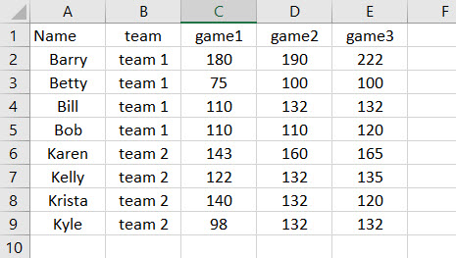
PivotTable Scenario
Barry and his family are in a bowling league with a neighbor’s family. He likes to keep track of the scores for both families in Excel. Barry has everyone’s individual scores for the three games they played, but he doesn’t know which family won each game?
Barry wants to know the answer to one key question: “Which family won each of the three games?”
The table he currently has contains all the individual scores, but it doesn’t show the totals. So how can Barry quickly calculate the family totals in Excel?
Barry’s Bowling Data
Click NEXT to continue.

Slide 8
Table versus PivotTable
By using his data, Barry can create a PivotTable to answer his question of which family won each game without making any calculations himself.
Standard Table of Barry’s Data
PivotTable of Barry’s Data
So how exactly was Barry able to re-organize his data and calculate the game scores with a PivotTable? Learn how on the following screens.
Click NEXT to continue.

Slide 9
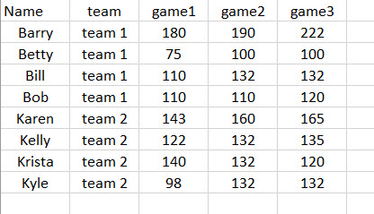
Organize Data
Click NEXT to continue.
Notes:
Audio Script: The first thing Barry had to do was organize his data in a way that is compatible for a PivotTable. To create a PivotTable, all data must be in columns with column headers. Fortunately, his data is already organized in this way.

Slide 10
Columns and Data Fields
Name
Team
Game 1
Game 2
Game 3
Click NEXT to continue.
Notes:
Audio Script: Once a table is organized into columns with column headers, the data can be organized into data fields. Think of a data field as a container of all the data in a column with a descriptive label on it. The name of the label will be the same as the name of the column header.

Slide 11
For Sean – Better explanation and description of how the data fields are organized by Excel.
Reorganizing Data Fields
PivotTable Fields Menu
Name
Team
Game 1
Game 2
Game 3
Click NEXT to continue.
Notes:
Audio Script: The data fields will then appear in the PivotTable Fields menu. The data fields will appear in the order they were in the original table of data. Now Barry is ready to start reorganizing his data to create a PivotTable.

Slide 12
Reorganizers
PivotTable Fields Menu
PivotTable Reorganizers
Name
Team
Filters
Columns
Game 1
Game 2
Rows
Values
Game 3
Click NEXT to continue.
Notes:
Audio Script: Barry has organized his data into data fields, but he still doesn’t have the answers to his questions. If he stops now he would simply be storing his data in a in the PivotTable Fields Menu. However, Barry does not want to just store his data, he wants to analyze it. Barry will need to use the reogranizers of a PivotTable to create connections between his data and begin to analyze it. There are four reorganizers, also known as areas, in a PivotTable: Filters, Columns, Rows, and Values.

Slide 13
Transfer Data Fields to Reorganizer Areas
PivotTable Fields Menu
PivotTable Reorganizers
Name
Name
Name
Team
Filters
Columns
Game 1
Name
Name
Game 2
Rows
Values
Game 3
Click NEXT to continue.
Notes:
Audio Script: Barry does not have to do very much to move his data fields out of storage and begin constructing his PivotTable. All he needs to do is transfer, or in Excel terms, drag and drop his data fields to one of the operators. Barry can move any data field to any of the four reorganizer areas.

Slide 14
Organize PivotTable Around a Question
Row
Value
Team
Game 1
Which team won each of the three games?
Game 2
Game 3
Notes:
Audio Script: So how does Barry decide where to transfer each data field? To answer that let’s return to Barry’s original question: “Which team won each of the three games?” The first part of his question is “which team” which indicates he should use the “Team” data field. The last part of his question has to do with the score of each of the three games, which indicates he should use the three game data fields. Now that he knows which data fields to use, he needs to determine where to transfer each one. Once again, think of Barry’s original question. In general, it is good to make the data field that is the subject of your question a Row reorganizer. In Barry’s case, this would mean making the Team data field a row. Then consider what value you are trying to calculate. In Barry’s case, this would mean making each of the three games a Value.

Slide 15
Create Row Labels
PivotTable Fields Menu
PivotTable Reorganizers
Name
Team
Filters
Columns
Game 1
Team
Game 2
Rows
Values
Game 3
Click NEXT to continue.
Notes:
Audio Script: Let’s take a look at what happens when Barry transfers the data fields to a reorganizer area. We determined Barry should make the Team data field a Row. So first he drags and drops Team to the Row reorganizer area.

Slide 16
Create Row Labels
PivotTable Fields Menu
PivotTable Reorganizers
Name
Team
Filters
Columns
Game 1
Team
Game 2
Rows
Values
Game 3
Click NEXT to continue.
Notes:
Audio Script: This automatically creates row labels for each of the two teams. You’ll notice there is also a Grand Total row has been created, however, there isn’t any data in the columns to indicate totals or scores for each game. Barry needs to set his values in order to calculate his data.

Slide 17
Create Values
PivotTable Fields Menu
PivotTable Reorganizers
Name
Team
Filters
Columns
Game 1
Game 1
Game 2
Game 2
Rows
Values
Game 3
Game 3
Click NEXT to continue.
Notes:
Audio Script: To calculate the totals for each game, Barry transfers the three game score data fields into the Values reorganizer area. Note, multiple data fields can be transferred to a reorganizer area.

Slide 18
Create Values
PivotTable Fields Menu
PivotTable Reorganizers
Name
Team
Filters
Columns
Game 1
Game 1
Game 2
Game 2
Rows
Values
Game 3
Game 3
Click NEXT to continue.
Notes:
Audio Script: Transferring the data fields to the Values reorganizer area does two things: it creates a column for each of the game data fields and calculates the totals for each team. The PivotTable also automatically creates a grand total of scores for each game. Barry has now analyzed his data using a PivotTable and answered his question. Team 2 won the first game with a score of 503 to 475. Team 2 also won the second game with a score of 556 to 532, and Team 1 won the third game with a score of 574 to 552.

Slide 19
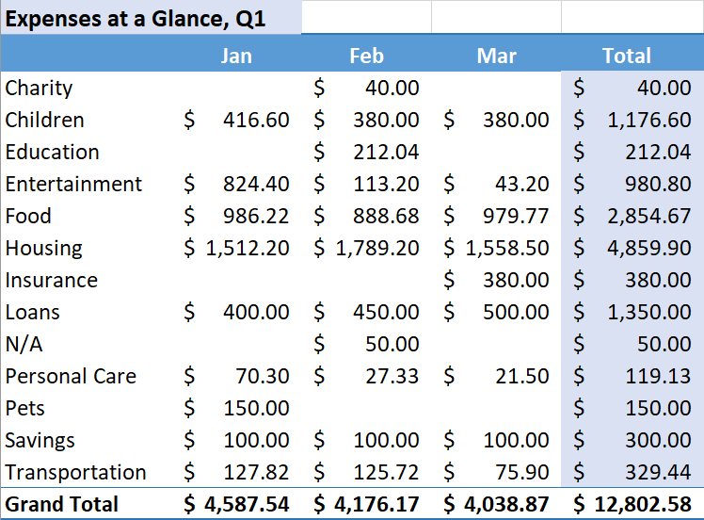
PivotTable Defined
PivotTables Offer More Features than standard Excel Tables
A PivotTable is a table that organizes and calculates statistics for a complex set of data and provides a simplified view of what is contained in the data. A PivotTable has several features compared to a standard table.
Click the boxes below to learn more about features of PivotTables.
Analyze Data
Analyze large sets of data
A PivotTable can be effectively used to analyze an extensive set of data.
In this example, a PivotTable was used to analyze a full quarter of expenses and determine where money is being spent.
Automated
Customizable
Visualize Data
Notes:
Developer Notes: Click to learn.

Slide 20
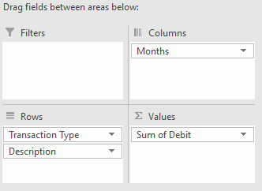
PivotTable Defined
PivotTables Offer More Features than standard Excel Tables
A PivotTable is a table that organizes and calculates statistics for a complex set of data and provides a simplified view of what is contained in the data. A PivotTable has several features compared to a standard table.
Click the boxes below to learn more about features of PivotTables.
Analyze Data
Automated
To create a PivotTable, there is no requirement or need to write a function to make calculations.
The table is created and updated based on which elements the user chooses to include.
Automated
Customizable
Visualize Data
Notes:
Developer Notes: Click to learn. Highlight box that is selected with glow.

Slide 21
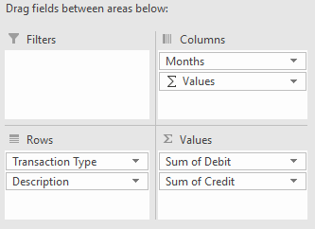
PivotTable Defined
PivotTables Offer More Features than standard Excel Tables
A PivotTable is a table that organizes and calculates statistics for a complex set of data and provides a simplified view of what is contained in the data. A PivotTable has several features compared to a standard table.
Click the boxes below to learn more about features of PivotTables.
Analyze Data
Customizable
A user only needs to be able to drag and drop elements to quickly create a PivotTable.
A PivotTable can be quickly created and customized using this process.
Automated
Customizable
Visualize Data
Notes:
Developer Notes: Click to learn. Highlight box that is selected with glow.

Slide 22
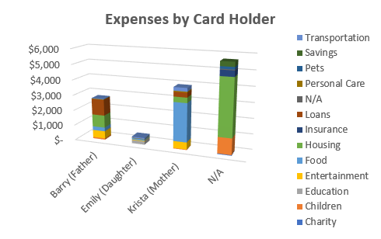
PivotTable Defined
PivotTables Offer More Features than standard Excel Tables
A PivotTable is a table that organizes and calculates statistics for a complex set of data and provides a simplified view of what is contained in the data. A PivotTable has several features compared to a standard table.
Click the boxes below to learn more about features of PivotTables.
Analyze Data
Visualize Data
PivotTables can be used to quickly make PivotCharts, which help to visualize data.
Users are able to produce several charts and filters for their data to enhance presentations.
Automated
Customizable
Visualize Data
Notes:
Developer Notes: Click to learn. Highlight box that is selected with glow.

Slide 23
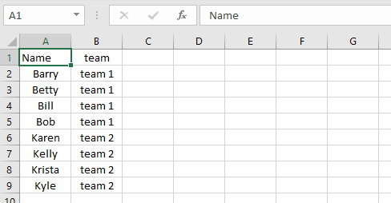
When to Use a PivotTable
A PivotTable is a useful tool for exploring complex of data, but not all sets of data require the available amount of sophistication and calculation capabilities.
We will go over a couple data sets to help you distinguish when a PivotTable may or may not be needed.
For example, if Barry only wanted to keep track of family names and who is on which team, he likely would not need a PivotTable, because the amount of data does not require much analysis.
Click on the image to see an expanded table with data that may require further exploration.

Slide 24
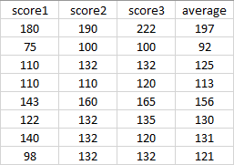
When to Use a PivotTable
A PivotTable is a useful tool for exploring complex of data, but not all sets of data require the available amount of sophistication and calculation capabilities.
We will go over a couple data sets to help you distinguish when a PivotTable may or may not be needed.
Here you see that if Barry were to keep track of more data, such as each person’s scores, he might need help to analyze the data.
For example, while he has the averages for each person, he hasn’t calculated each team’s overall scores and averages.
Click NEXT to continue.
Notes:
.

Slide 25
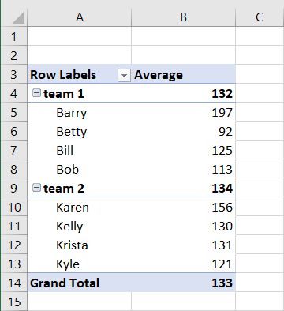
Attributes of a PivotTable
There are several attributes and features of a PivotTable that Barry uses to break down and analyze his data.
Use left and right arrows to click through the slideshow of PivotTable features.
Categories and Sub-categories
PivotTables can be used to organize data into a categories and sub-categories.
In the example on the right, Barry has organized his data into categories of “team 1” and “team 2” scores, and there is also a sub-category for individual team member scores.
1
2
3
4
5
6
Notes:
Developer notes: Modify P115_01_25. Use slideshow template and replace image and text.

Slide 26
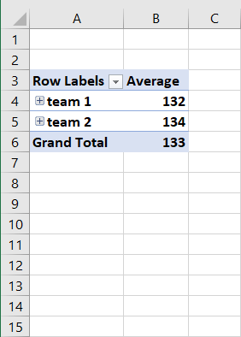
Attributes of a PivotTable
There are several attributes and features of a PivotTable Barry can use to break down and analyze his data.
Use left and right arrows to click through the slideshow of PivotTable features.
Expand and Contract Categories
Categories can be expanded and contracted. This is useful to focus in on the main category of data.
For example, if Barry wanted to compare only the team scores, he could click on the “-” icon next to “team 1” and “team 2” to view only the average team scores. He would only need to click on the “+” to expand the view back to include the individual team member scores.
1
2
3
4
5
6

Slide 27
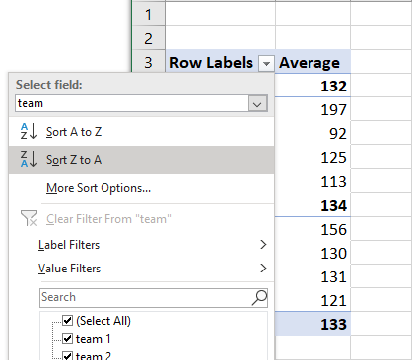
Attributes of a PivotTable
There are several attributes and features of a PivotTable Barry can use to break down and analyze his data.
Use left and right arrows to click through the slideshow of PivotTable features.
Sort Data
Data can also be sorted in a PivotTable in several different ways. This allows the data to be viewed from different perspectives.
For example, if Barry wanted to re-sort the scores by alphabetical order from “Z to A” instead of “A to Z” he could simply click on the down arrow icon next to “Row Labels.”
1
2
3
4
5
6

Slide 28
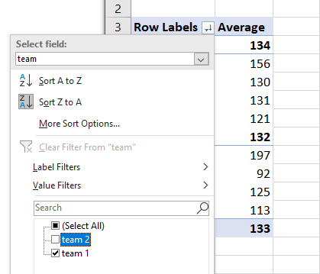
Attributes of a PivotTable
There are several attributes and features of a PivotTable Barry can use to break down and analyze his data.
Use left and right arrows to click through the slideshow of PivotTable features.
Filter Data
Date can also be filtered in a PivotTable to focus in on one specific aspect of the data.
For example, if Barry wanted to view only the data for his family’s team, he could un-check the box next to “team 2” in the filter menu.
1
2
3
4
5
6

Slide 29
Attributes of a PivotTable
There are several attributes and features of a PivotTable Barry can use to break down and analyze his data.
Use left and right arrows to click through the slideshow of PivotTable features.
Calculate Statistics
A PivotTable has the powerful ability to quickly calculate statistics for a data set. The calculations are done automatically through menu selections without the need to enter formulas or functions.
For example, Barry was able to calculate the average score for each team, as well as the average score for each team member.
1
2
3
4
5
6

Slide 30
Attributes of a PivotTable
There are several attributes and features of a PivotTable Barry can use to break down and analyze his data.
Use left and right arrows to click through the slideshow of PivotTable features.
Summary and Totals
Similar to calculating statistics, PivotTables also automatically calculate totals to provide a summary of the data.
For example, in addition to team and individual averages, Barry is also able to view the overall average score for both teams.
1
2
3
4
5
6
Click NEXT to continue.

Slide 31
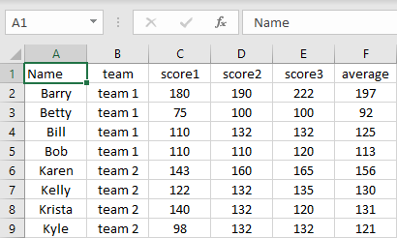
Source Data, Table, and PivotTable
If you have ever used Excel, then you have probably created a standard table with rows and columns. The examples below compares source data, a standard table in Excel and a PivotTable.
Click each example.
Source Data
Standard Table
PivotTable
Source data is organized, however, there are no functions, formulas, or sorting that has been done in Excel.
Notes:
Modify layout for P520_01_20.

Slide 32
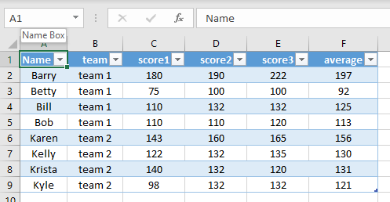
Source Data, Table, and PivotTable
Source Data, Table, and PivotTable
If you have ever used Excel, then you have probably created a standard table with rows and columns. The examples below compares source data, a standard table in Excel and a PivotTable.
Click each example.
Source Data
Standard Table
PivotTable
A standard table can be quickly created in Excel by highlighting source data and selecting Format as Table.
A table is formatted for easier viewing and enables sorting by column header.
Notes:
Modify layout for P520_01_20

Slide 33
Source Data, Table, and PivotTable
Source Data, Table, and PivotTable
If you have ever used Excel, then you have probably created a standard table with rows and columns. The examples below compares source data, a standard table in Excel and a PivotTable.
Click each example.
Source Data
Standard Table
PivotTable
A PivotTable goes beyond organizing and sorting the data already contained in the table.
Data can be sorted similar to a standard table, but it can also be filtered and organized into categories and sub-categories.
A PivotTable enables a user to dive deeper and learn more of the “story” within the data.
Click NEXT to continue.
Notes:
Modify layout for P520_01_20

Slide 34
Compare Source Data, Table, and PivotTable
Source Data
Standard Table
PivotTable
Data is organized into columns
No sorting capabilities
No calculations of data
Data is organized by column headers
Data can only be sorted by column header
No calculations of data
Data is organized by column headers and row labels
Data can be sorted and filtered using column headers and row labels
Data can be analyzed using automated calculations
Notes:
Developer Note: Possible interactions. Use Sticky Notes interaction slide-in? Sign drops in and “bounce” one at a time. Re-use images with faded bottom from previous slide.

Slide 35
Knowledge Check
Question 1 of 3
Which of these scenarios would benefit most from the use of a PivotTable?
Select the correct answer.
A coach wants to analyze which players average the most points in a season
An equipment manager wants to keep track of players’ shirt sizes
A maintenance supervisor needs to create a schedule for his staff
Notes:
Developer Notes: 2 tries

Slide 36
Knowledge Check
Question 2 of 3
Which are features of a PivotTable?
Select all the correct answers, then click SUBMIT.
Create sub-categories
Calculate statistics
Filter data
Write functions
SUBMIT
Notes:
Developer Note: Modify x101_06_035 (Multi-Select – 2 Tries)

Slide 37
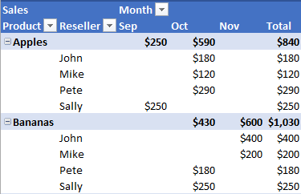
Knowledge Check
Question 3 of 3
Based on the image of the PivotTable, which of the values listed below is an example of a sub-category?
Select the correct answer.
Bananas
Sally
Total
$250
Notes:
Developer Notes: Modify P405_03_85. Green area is a hotspot. Only when any

Slide 38
Create a PivotTable
PivotTables are intended to provide a powerful tool for data analysis with minimal effort.
In this lesson you will learn the steps to create a PivotTable from a basic table in Excel, as well as how to use a PivotTable to analyze data.
This topic explains:
Requirements for the source data for a PivotTable
Steps to create a PivotTable using source data
How to customize a PivotTable using the PivotTable Fields menu
Click NEXT to continue.
Notes:
Topic title with Lead in and objectives

Slide 39
Create a PivotTable
Three Steps to Create a PivotTable
Now that Barry has his source data in a compatible format for PivotTables, he can open his file in Excel and convert it to a PivotTable.
The steps to create a PivotTable:
1. Format Source Data
3. Create PivotTable
2. Select Data to Analyze
Notes:
Re-use image: D220_01_40

Slide 40
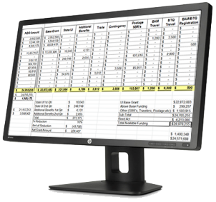
How to Format Source Data
Format Source Data
Create PivotTable
Select Data to Analyze
The first thing you need for any PivotTable is source data.
Barry uses his bank’s online statements to keep up with his monthly expenses, but he’s decided he would like to take a closer look at his family’s budget.
Before Barry can analyze any of his financial records, he first needs to get the source data properly formatted. So Barry starts by downloading his bank statements into an Excel-friendly format.
Select the computer screen to learn more about how to format source data.
Click NEXT to continue.
Notes:
No additional on-screen text or action.

Slide 41
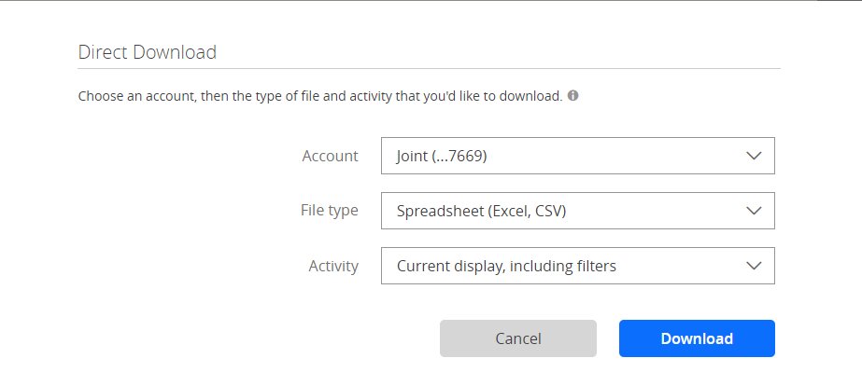
How to Format Source Data
Click the highlighted area in Barry’s bank download tool to learn about compatible formats for source data.
File format must be Excel or CSV
When downloading his bank records, Barry selects Excel or CSV format.
CSV stands for “comma-separated values” and is a simple file format that is compatible with Excel.
Click NEXT to continue.
Notes:
Developer Note: Re-create text in Storyline. Simplify text to remove and distracting/unnecessary content.

Slide 42
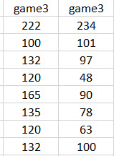
Source Data for a PivotTable
You will need to organize your source data in a very specific manner prior to creating a PivotTable.
Click the highlighted areas to see how to format source data.
Columns and headers
Each column in the source data should have a header and there should be no duplicate headers.
Click NEXT to continue.
Notes:
Developer note: Fade background of the parts of the image not emphasized when each pin is clicked.

Slide 43
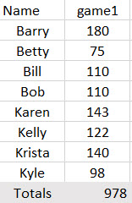
Source Data for a PivotTable
You will need to organize your source data in a very specific manner prior to creating a PivotTable.
Click the highlighted areas to see how to format source data.
No Totals or Sub-totals
Totals or sub-total calculations of the source data should not be included.
Click NEXT to continue.
Notes:
Developer note: Fade background of the parts of the image not emphasized when each pin is clicked.

Slide 44
Source Data for a PivotTable
You will need to organize your source data in a very specific manner prior to creating a PivotTable.
Click the highlighted areas to see how to format source data.
No row labels
The first column should contain only data. There should not be any row labels for organizing data in the rest of the table. For example, row labels like “team 1” and “team 2” should not be used.
Click NEXT to continue.
Notes:
Developer note: Fade background of the parts of the image not emphasized when each pin is clicked.

Slide 45
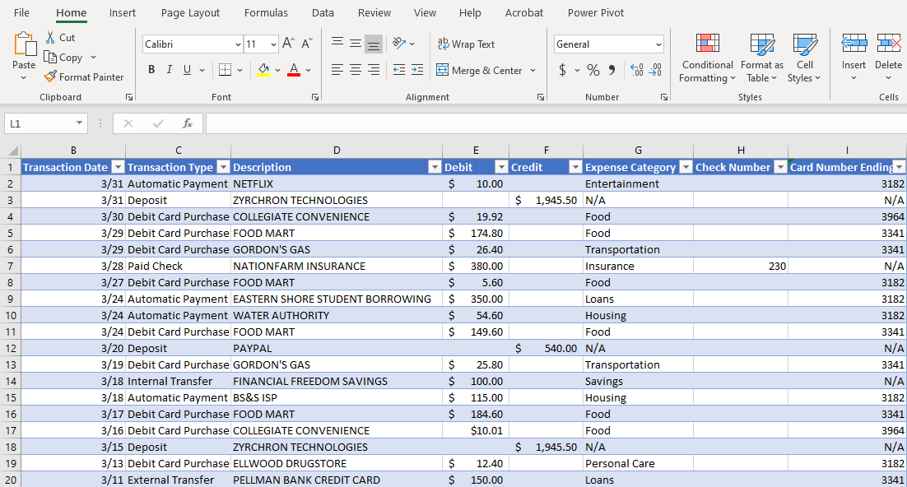
Step 1: Navigate to Insert Menu
Highlight the parts of the source data table you want to convert to a PivotTable, then go to the main menu and select Insert.
Notes:
Developer notes: Green rectangle is hotspot, not a visible green shape. Orange arrow only appears if learner incorrectly clicks somewhere other than the hotspot.

Slide 46
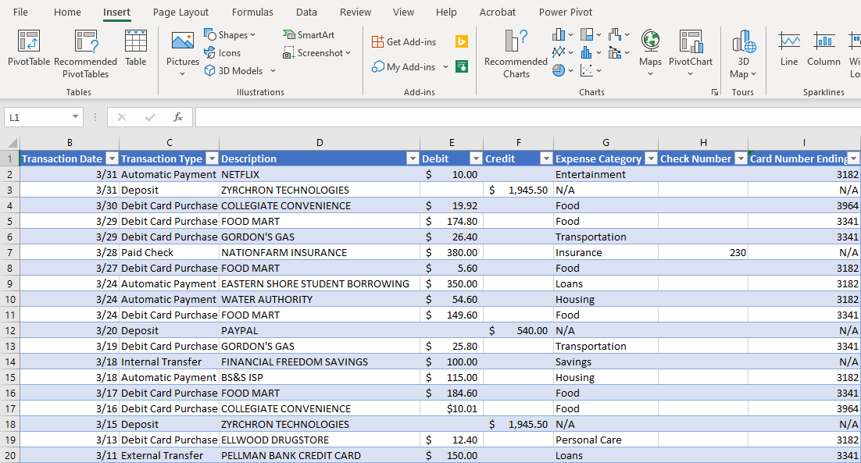
Step 2: Select PivotTable Button
D220_03_20
Note the ribbon changed to the Insert menu options.
In the Insert ribbon, select the PivotTable button.
Notes:
Developer notes: Green rectangle is hotspot, not a visible green shape. Orange arrow only appears if learner incorrectly clicks somewhere other than the hotspot.

Slide 47
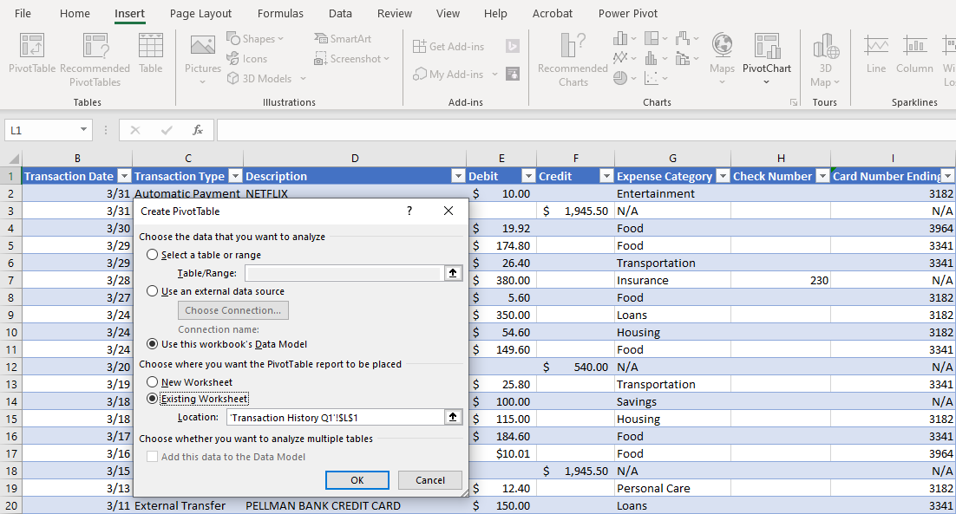
Step 3: Verify Source Data
The Create PivotTable box appears.
In the Create PivotTable dialog box, verify the Existing Worksheet and table is selected.
In this example the cells to be included are “$L$1” in the “Transaction History Q1” worksheet. Select OK
Notes:
Developer notes: Green rectangle is hotspot, not a visible green shape. Orange arrow and highlight box only appear if learner incorrectly clicks somewhere other than the hotspot.

Slide 48
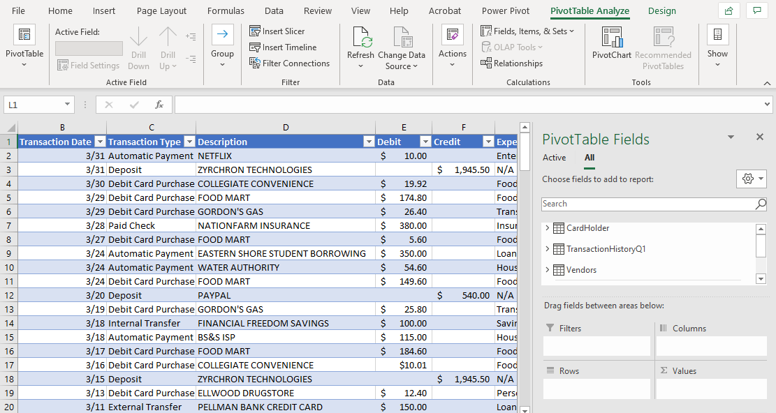
PivotTable Fields Box Appears
The PivotTable Fields box appears.
Barry is now ready to select which fields he would like in his PivotTable.
Click Next to learn about the options in the PivotTable Fields menu.
Notes:
Static screen, learner should click Next to continue.

Slide 49
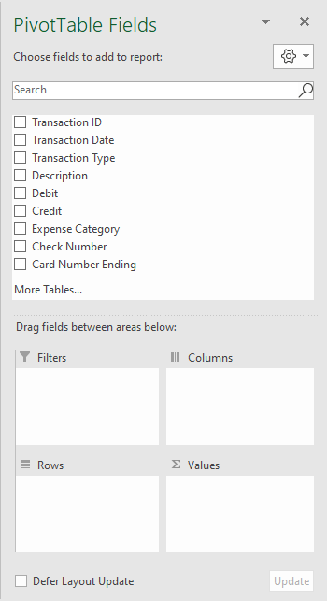
Description of PivotTable Fields Options
Select the area next to each arrow to learn more about the available PivotTable Fields options
Click NEXT to continue.
Notes:
Developer notes: Dialog boxes appear on user click of each pushpin. When pushpin has been selected/rolled over, the orange arrow appears. User can only click Next when all pushpins have been selected.

Slide 50
Description of PivotTable Fields Options
Data Fields
Every column of data from the source data is turned into a data field. Each data field contains all the data from its corresponding column in the source data.
For example, the Transaction Date data field in the menu contains all the rows of dates from the column in the source data.
Click NEXT to continue.
Notes:
Developer notes: Dialog boxes appear on user click of each pushpin. When pushpin has been selected/rolled over, the orange arrow appears. User can only click Next when all pushpins have been selected.

Slide 51
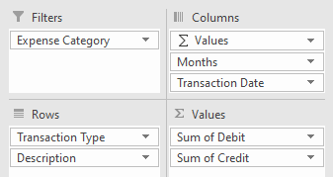
Description of PivotTable Fields Options
Select the area next to each arrow to learn more about the available PivotTable Fields options
Reorganizer Areas
To create a PivotTable, data fields must be placed in one of the four areas:
Filters – enables user to focus on specific elements or cells of data within a data field.
Columns – divides data into categories and sub-categories.
Rows – groups data into categories and sub-categories along the left side of the table.
Values – summarizes and calculates data fields.
When data field is assigned to an area, the PivotTable updates based on where it was placed.
Click NEXT to continue.
Notes:
Developer notes: Dialog boxes appear on user click of each pushpin. When pushpin has been selected/rolled over, the orange arrow appears. User can only click Next when all pushpins have been selected.

Slide 52
Description of PivotTable Fields Options
Update PivotTable
A user can choose to either have a PivotTable update automatically or by using the “Update” button.
If the “Defer Layout Update” button is not selected, the Update button will be grayed out and a PivotTable will update as soon as a data field is placed in an area.
If the “Defer Layout Update” button is selected, the Update button will be available and the PivotTable will only update when the user clicks on it.
Click NEXT to continue.
Notes:
Developer notes: Dialog boxes appear on user click of each pushpin. When pushpin has been selected/rolled over, the orange arrow appears. User can only click Next when all pushpins have been selected.

Slide 53
PivotTable Fields menu: Assign Data Fields
Watch the video to learn how to customize a PivotTable by assigning data fields to the four areas.
Use the slider bar below to pause or replay the video.
Notes:
Audio script: In order to construct your PivotTable, you will need to assign data fields into the four areas. There are different methods for moving data fields into each of the four areas. First, you can simply check the box next to a data field and Excel will automatically place it in an area. The placement is automated based on what type of data is contained in the data field. For example, a number-based data field such as “Debit” that has dollar amounts, will be placed in the Values area once you check its box. Conversely, text-based data fields like “Transaction Type” is likely to be assigned to the Rows or Columns area.
However, what if you had wanted to make the “Debit” data field a row label? What Excel assumed you wanted would not have helped you. The automated assignment of the check boxes is why you will find that dragging and dropping the data fields gives you more control when constructing your PivotTable. You can select any available data and field and quickly drag and drop it in any of the four areas. This way it is possible to customize your PivotTable however you would like. For example, a text-based data field like Transaction Type can be assigned to “Values” and a number-based data field like Debit can be assigned to “Rows.”
You may also decide to check the boxes you wish to include and then drag and drop them from area to area to customize them. This method gives you the opportunity to see how Excel would construct your PivotTable using the included data fields. You may find the automated table helpful, or you may choose to slightly adjust it by dragging and dropping certain data fields to different areas.
Developer notes: Modify T215_002_015. Video plays when user clicks “Play” button. Video automatically enlarges to full screen with media controls underneath.

Slide 54
PivotTable Fields Menu: Set Row Labels
Watch the video to learn how to set up additional row labels and subcategories for a PivotTable.
Use the slider bar below to pause or replay the video.
Notes:
Audio Script: To begin constructing a PivotTable, assigning a data field to the Rows area is a good place to start. Think about what question you are trying to answer using the source data. For example, Barry is interested in seeing where his family is spending all their money? So Barry starts by assigning “Transaction Type” to the Rows area. This will orient the PivotTable around the types of transaction his family has made from the source data.
Row labels can be used to filter information. By selecting the drop down menu on the row label, certain types of data can be selected. If Barry wanted to see only cash withdrawals his family has made, he could unselect the other data in the menu and check “Cash Withdrawals.” After he selects the “OK” button, the table will automatically update. To return to the original PivotTable, he can simply “Select All” in the dropdown menu and select “OK.”
You can also assign multiple row labels. If Barry wanted to further specify where his family is spending money he could add “Descriptions” to the Rows area. The PivotTable will automatically update to show the additional row label as a subcategory to Transaction Type. Row Labels can be contracted or expanded depending on what data needs to be viewed.
The order of how the data fields appear in the area is important. For example, if Barry wanted to make the Description of transactions the primary focus of his PivotTable, he could drag it above Transaction Type. Description would become the top row label, and Transaction Type would become a subcategory.
Developer notes: Modify T215_002_015. Video plays when user clicks “Play” button. Video automatically enlarges to full screen with media controls underneath.

Slide 55
PivotTable Fields Menu: Set Up Values
Watch the video to learn how to set up additional Values in a PivotTable.
Use the slider bar below to pause or replay the video.
Notes:
Audio Script: A critical feature of the PivotTable Fields menu is the Values area. By assigning data fields to the Values area, a PivotTable will automatically update with the calculated data. For example, if Barry wants to see how much his family is spending he could assign the Debit data field as a value.
Oftentimes for numerical data, the Value will default to calculating the sum. So Barry’s PivotTable is showing him where money is being spent on the whole. However, Barry may also be interested in seeing the averages of his family’s purchases. To do this, he would need to navigate to the Value Fields Settings menu. He would need to simply select the dropdown menu and click on the Value Fields Setting option. When the dialog box appears, he could then select the “Averages” option and click OK. The PivotTable updates with the calculated averages for his family spending instead of the sum totals.
Developer notes: Modify T215_002_015. Video plays when user clicks “Play” button. Video automatically enlarges to full screen with media controls underneath.

Slide 56
PivotTable Fields Menu: Set Data Filter
Watch the video to learn how to set up a data filter for a PivotTable.
Use the slider bar below to pause or replay the video.
Notes:
Audio script: Filters are a useful tool to focus in on information in an existing PivotTable. If there are certain variables within a PivotTable that need to be investigated, a data field can be assigned to the Filters area. Data fields will rarely ever be automatically assigned by Excel to the Filters area, so you will likely need to use the drag and drop method to create a filter.
Let’s say Barry wants to learn more about how his family spent money on specific dates. In this case, he is curious what was spent on the first two days of the year, January 1 and 2. He could assign “Transaction Date” to the Filters area by dragging and dropping it there. A dropdown menu will appear above the PivotTable. Then, in the Filters dropdown menu, he could select the dates he wanted to focus on. By clicking “OK”, the PivotTable will automatically update to show you only the purchases/debits from the selected dates. If Barry wanted to return to the full PivotTable with data from all dates, he could select “All” in the dropdown menu.
Developer notes: Modify T215_002_015. Video plays when user clicks “Play” button. Video automatically enlarges to full screen with media controls underneath.

Slide 57
PivotTable Fields Menu: Set Columns of Data
Watch the video to learn how to set up multiple Columns and Column Labels for a PivotTable.
Use the slider bar below to pause or replay the video.
Notes:
Audio Script: Similar to Filters, columns can be used to create sub-categories and further explore data in a PivotTable. In an existing PivotTable with a single column, an additional data field can be assigned to the Columns area by dragging and dropping it there.
For example, if Barry wanted to see a full breakdown of how money was spent each month. Rather than using a Filter, he could assign the Months data field to the Columns area. The PivotTable will automatically update with a “Column Labels” dropdown menu. Barry would be able to see all of the data as well as filter by month if he chose.
Developer notes: Modify T215_002_015. Video plays when user clicks “Play” button. Video automatically enlarges to full screen with media controls underneath.

Slide 58
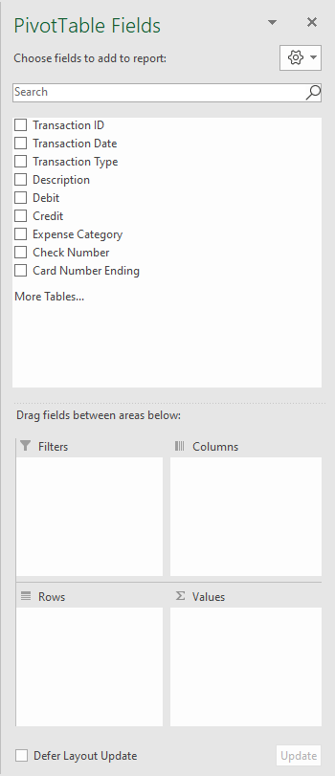
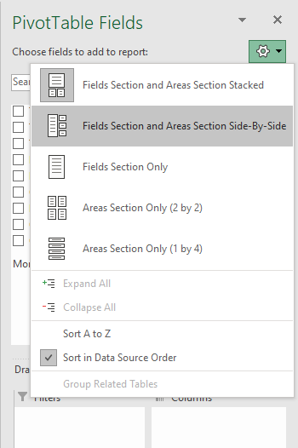
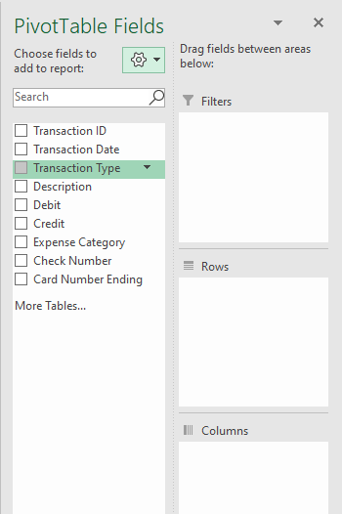
Set Layout for PivotTable Fields Menu
The Settings icon enables you to re-format the layout of the PivotTable Fields menu, as well as sort your data fields, e.g. Transaction ID, Transaction Type, etc.
For example, the PivotTable Fields menu can be re-formatted from a “Stacked” view to a “Side-By-Side” view.

Slide 59
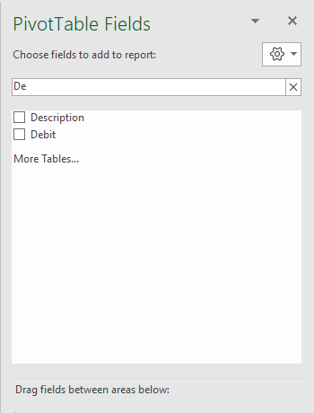
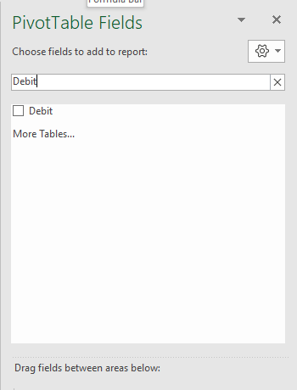
Search for data fields
The Search field is specifically for the data fields in the menu, e.g. Transaction ID, Transaction Date, etc. In the example below, all of the data fields are viewable. However, if there were so many data fields that not all of them could not be shown on screen, the Search bar is a useful tool.
For example, if the Debit data field was not viewable, a user could type in “Debit” to bring it to the top of the menu. The options begin to be sorted as you type. Even typing the letters “De” immediately limits all available options to those that begin with the letters “De.”

Slide 60
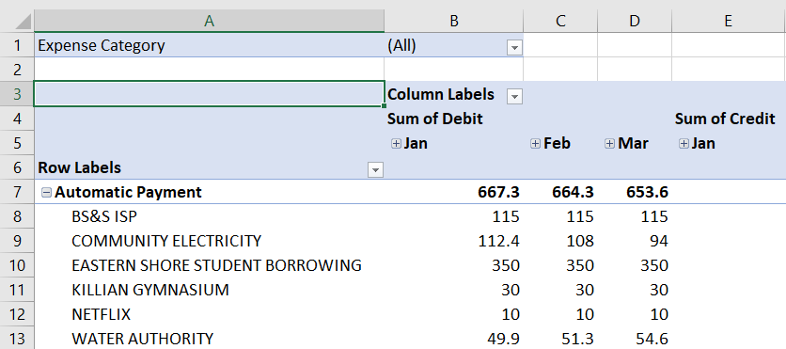
Knowledge Check
Question 1 of 3
Select the highlighted area that is an example of a Filter.
Click on the correct answer.
Notes:
Developer Note: The highlighted area for “Expense Cateogry” is the correct answer.

Slide 61
Knowledge Check
Question 2 of 3
How do you change the type of calculation you would like to see for a data field in a PivotTable.
Select the correct answer.
Adjust the calculation in the Value Fields Setting dialog box
Drag and drop the data field into the Filters area
Calculations cannot be changed, they are automated by Excel
None of the above are correct
Notes:
Developer Note: The correct answer is “Adjust the calculation in the Value Fields Setting dialog box”

Slide 62
Knowledge Check
Question 2 of 3
Source data for a PivotTable should contain:
Select all the correct answers, then click SUBMIT.
Only columns with column headers
No duplicate column headers
No row labels
Sub-totals and grand totals
SUBMIT
Notes:
Developer Note: The correct answer is first three boxes selected. “Sub-totals and grand totals” is a distractor and not correct.

Slide 63
Practice Scenario: Create a PivotTable
In this section you will practice creating a PivotTable using source data.
In this topic you will demonstrate:
The steps to create a PivotTable using source data
How to use the PivotTable Fields menu to create a PivotTable
How to customize a PivotTable
Click NEXT to continue.
Notes:
Topic title with Lead in and objectives

Slide 64
Scenario: Create and Customize a PivotTable
Using a PivotTable to Explore Finances
Now that you are familiar with the parts of a PivotTable and how to customize one using the PivotTables Field menu, you will now have the opportunity to create one yourself.
Barry wants to answer the following question: How is his family’s money is being made and spent in a given time period?
In the following scenario you will:
Start with Barry’s financial records source data
Create a PivotTable
Use the PivotTable Fields menu to customize the PivoTable

Slide 65
Practice Scenario: Create a PivotTable
It is time to practice each step in the process to create a PivotTable based on Barry’s financial records.
Click START when you are ready to begin the Practice Scenario.
START
In the following scenario:
You will be expected to complete a series of tasks.
You will be prompted to complete one task at a time.
You will not be able to move onto the next task until you have completed the current task.
You will have two attempts to complete each task.
If you do not correctly complete a task on your first attempt, you will receive a hint.
If you do not complete the task correctly after two tries, you will receive explicit instructions on how to complete the task.
Notes:
Developer Notes: Modify x101_10_027

Slide 66
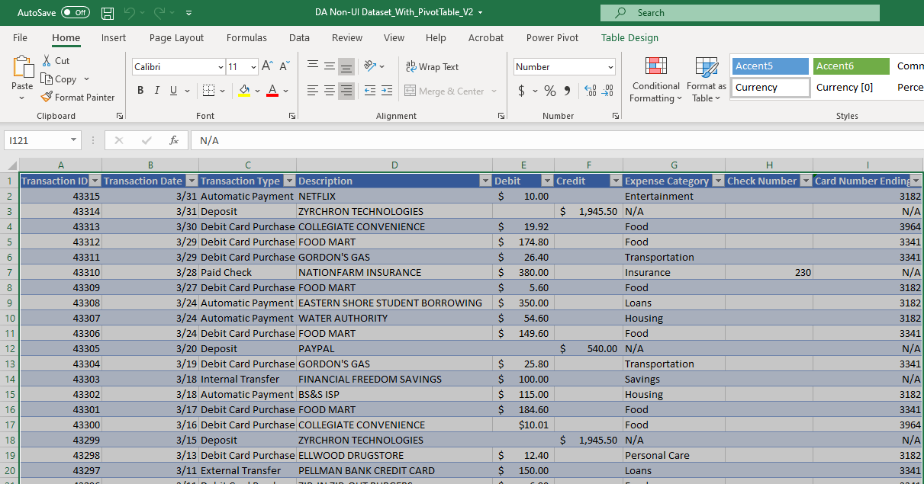
Task 1: Navigate to PivotTable Button
Navigate to correct ribbon
The source data table has been selected for you.
Select the menu in the top ribbon that contains the PivotTable button.
Tip
The PivotTable button is in the Insert ribbon.
Insert Menu
Select Insert in the top menu ribbon to navigate to the PivotTable button.
Notes:
Developer notes: Green rectangle is hotspot, not a visible green shape. Orange arrow only appears if learner incorrectly clicks somewhere other than the hotspot.
Initial prompt: Navigate to correct ribbon text box appears.
First incorrect attempt: Tip box appears.
Second incorrect attempt: Orange arrow appears along with Insert Menu box.

Slide 67
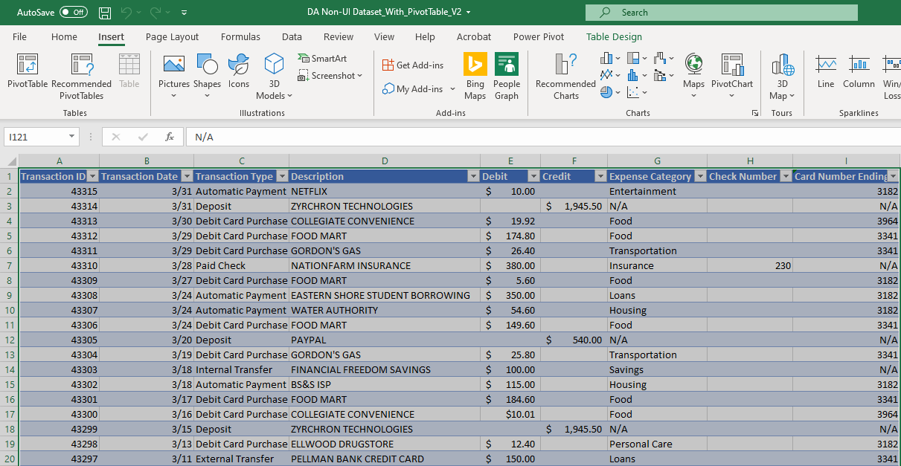
Task 2: Select Button to Create PivotTable
Select the correct button
Select the correct button in the top ribbon to create a PivotTable.
Tip
Choose the correct button the left side of the Insert ribbon.
PivotTable button
Select the PivotTable button on the left of the top ribbon.
Notes:
Developer notes: Green rectangle is hotspot, not a visible green shape. Orange arrow only appears if learner incorrectly clicks somewhere other than the hotspot.
Initial prompt: Select the correct button text box appears.
First incorrect attempt: Tip box appears along with PivotTable button box

Slide 68
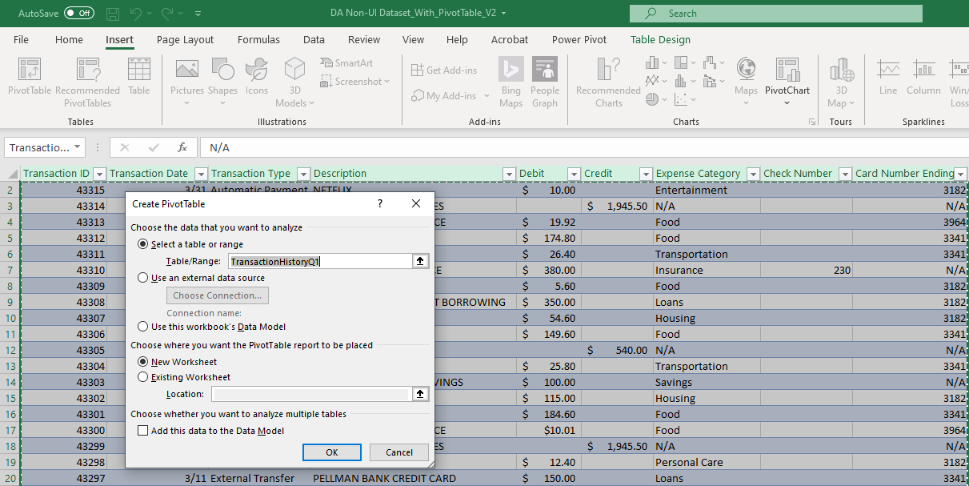
Task 3: Confirm Correct Table is Selected
Confirm Table is Selected
Verify and confirm the correct table is selected.
Tip
The “TransactionHistoryQ1” table is correctly selected, so you can select the button to confirm.
Select OK button
Select the OK button at the bottom of the Create PivotTable menu.
Notes:
Developer notes: Green rectangle is hotspot, not a visible green shape. Orange arrow only appears if learner incorrectly clicks somewhere other than the hotspot.
Initial prompt: Confirm table is selected text box appears.
First incorrect attempt: Tip box appears.
Second incorrect attempt: Orange arrow appears along with Select OK button box

Slide 69
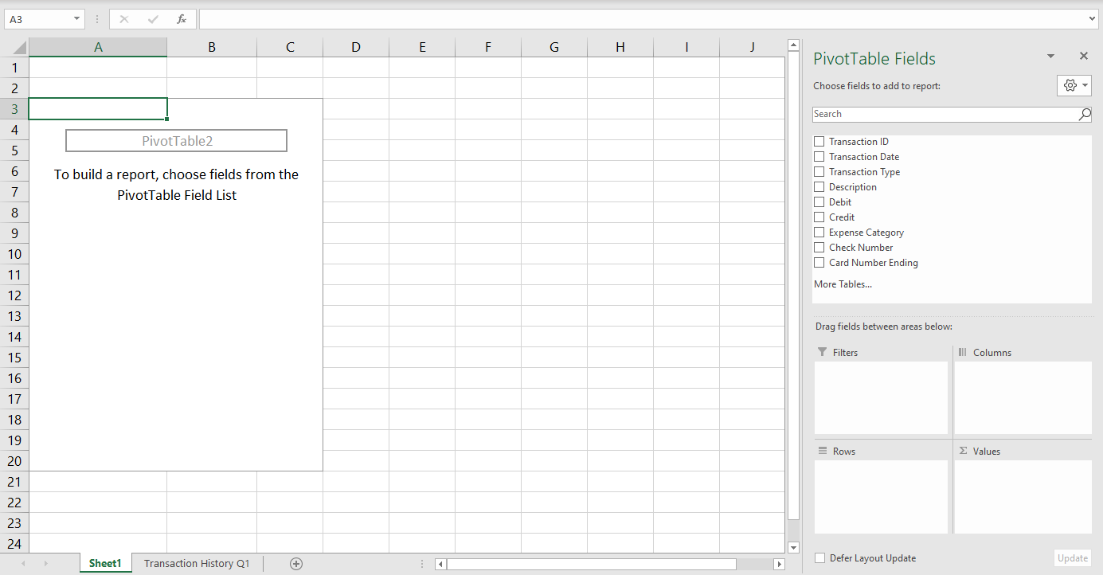
Task 4: Set Row Label
Set Row Label
Set the data field that will enable you to view the type of transactions that have been made as the Row Label.
Tip
Select the box next to the data field that has to do with the type of transaction and set it as a row.
Select Transaction Type
Select Transaction Type and drag it to the Rows box. This will set Transaction Type as the row label for the PivotTable.
Notes:
Developer notes: Drag and drop: Learner should drag Transaction Type to Rows hotspot. Green boxes are only hotspots, not visible to learner. Orange arrow only appears if learner incorrectly clicks somewhere other than the hotspot.
Initial prompt: Set Row Label text box appears.
First incorrect attempt: Tip box appears.
Second incorrect attempt: Orange arrow appears with prompt “Select Transaction Type”

Slide 70
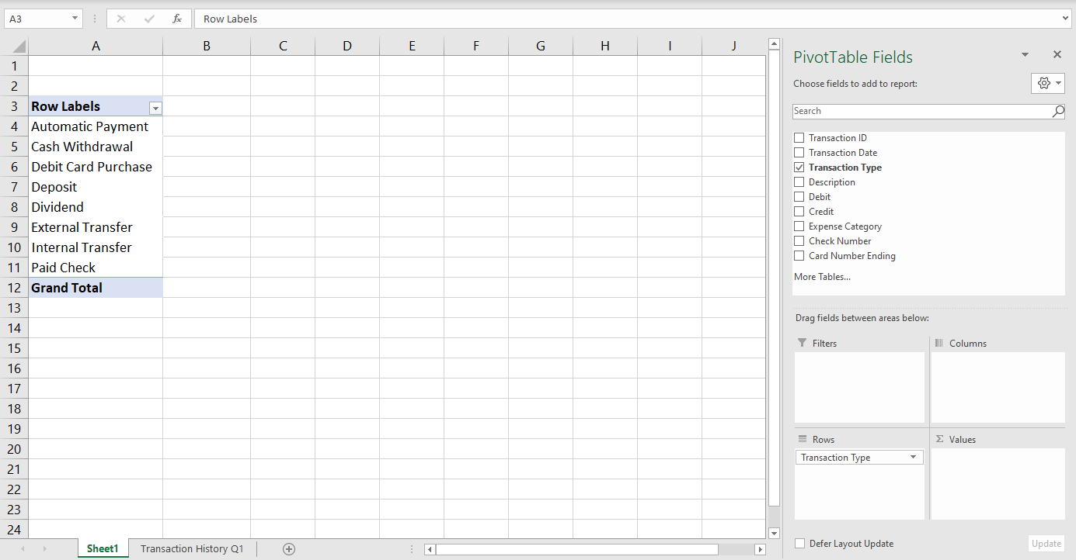
Task 5: Set Value
Set Value
Set the data field that enable you to view the total debits for each transaction type.
Tip
Select the box next to the data field that has to do with debits transaction and set it as the value.
Select Debit
Select the check box next to Debit and drag it to the Values box. This will set automatically create the Value for “Sum of Debit.”
Notes:
Developer notes: Drag and drop: Learner should drag Debit to Values hotspot. Green boxes are only hotspots, not visible to learner. Orange arrow only appears if learner incorrectly clicks or drags somewhere other than the hotspot.
Initial prompt: Select Value text box appears.
First incorrect attempt: Tip box appears.
Second incorrect attempt: Orange arrow appears with prompt “Select Debit”

Slide 71
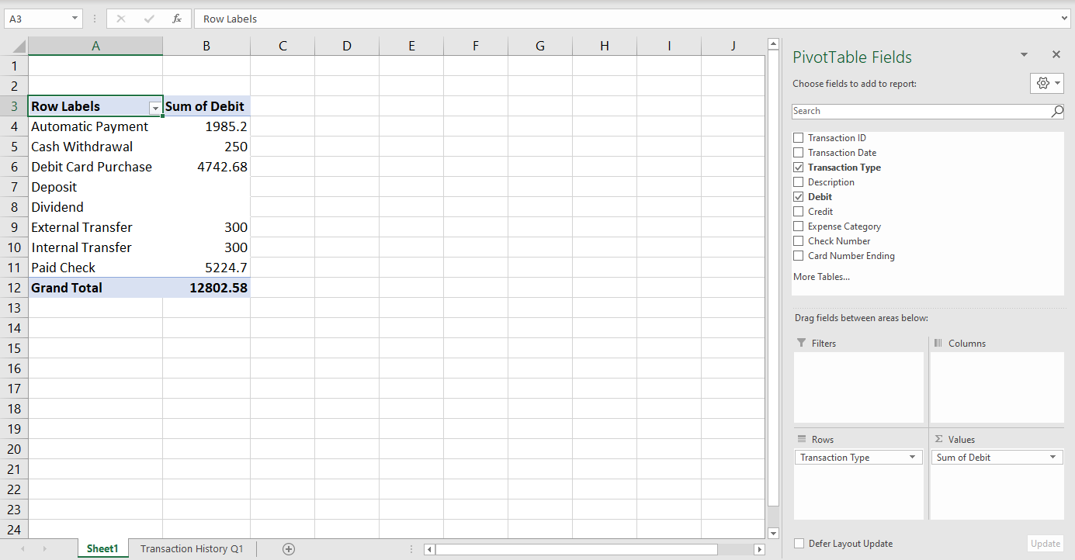
Task 6: Select Second Value
Set Value
Set the data field that enable you to view the total credits for each transaction type.
Tip
Select the box next to the data field that has to do with credit transaction and set it as the value.
Select Credit
Select the check box next to Credit and drag it to the Values box. This will set automatically create the Value for “Sum of Credit.”
Notes:
Developer notes: Drag and drop: Learner should drag Credit to Values hotspot. Green boxes are only hotspots, not visible to learner. Orange arrow only appears if learner incorrectly clicks or drags somewhere other than the hotspot.
Initial prompt: Select Value text box appears.
First incorrect attempt: Tip box appears.
Second incorrect attempt: Orange arrow appears with prompt “Select Credit”

Slide 72
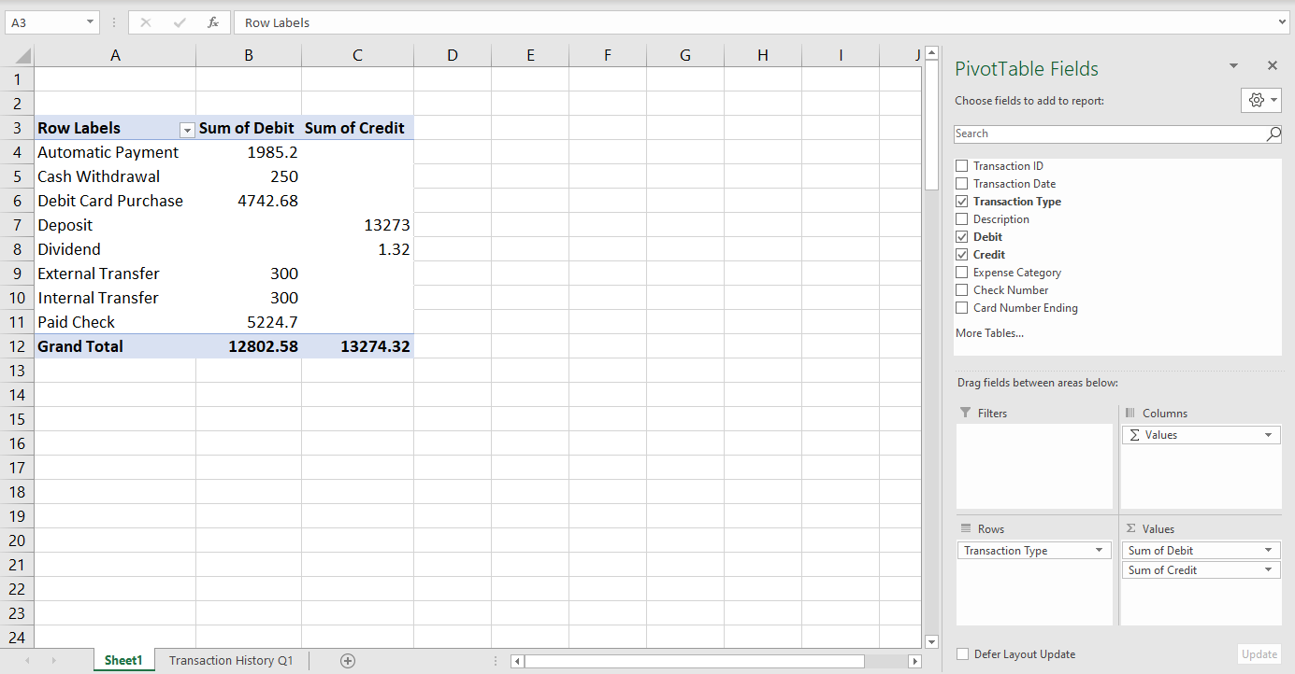
Task 7: Set Row Label Subcategory
Set Row Label Subcategory
Set the data field that will enable you to view additional information on the transaction type.
Tip
Select the box next to the data field that has to do with the description of transactions and set it as a row.
Select Description
Select Description and drag it to the Rows box. This will set Description as a row label subcategory of Transaction Type the row label for the PivotTable.
Notes:
Developer notes: Drag and drop: Learner should drag Description to Rows hotspot. Green boxes are only hotspots, not visible to learner. Orange arrow only appears if learner incorrectly clicks somewhere other than the hotspot.
Initial prompt: Set Row Label Subcategory text box appears.
First incorrect attempt: Tip box appears.
Second incorrect attempt: Orange arrow appears with prompt “Select Description”

Slide 73
Task 8: Set Column Subcategory
Set Column Subcategory
Set the data field that will enable you to view additional information for the dates of each transaction.
Tip
Select the data field that has to do with the dates for transaction and set it as a column.
Select Transaction Date
Select Transaction Date and drag it to the Columns box. This will set Description as a row label subcategory of Transaction Type the row label for the PivotTable.
Notes:
Developer notes: Drag and drop: Learner should drag Transaction Date to Columns hotspot. Green boxes are only hotspots, not visible to learner. Orange arrow only appears if learner incorrectly clicks somewhere other than the hotspot.
Initial prompt: Set Column Subcategory text box appears.
First incorrect attempt: Tip box appears.
Second incorrect attempt: Orange arrow appears with prompt “Select Transaction Date”

Slide 74
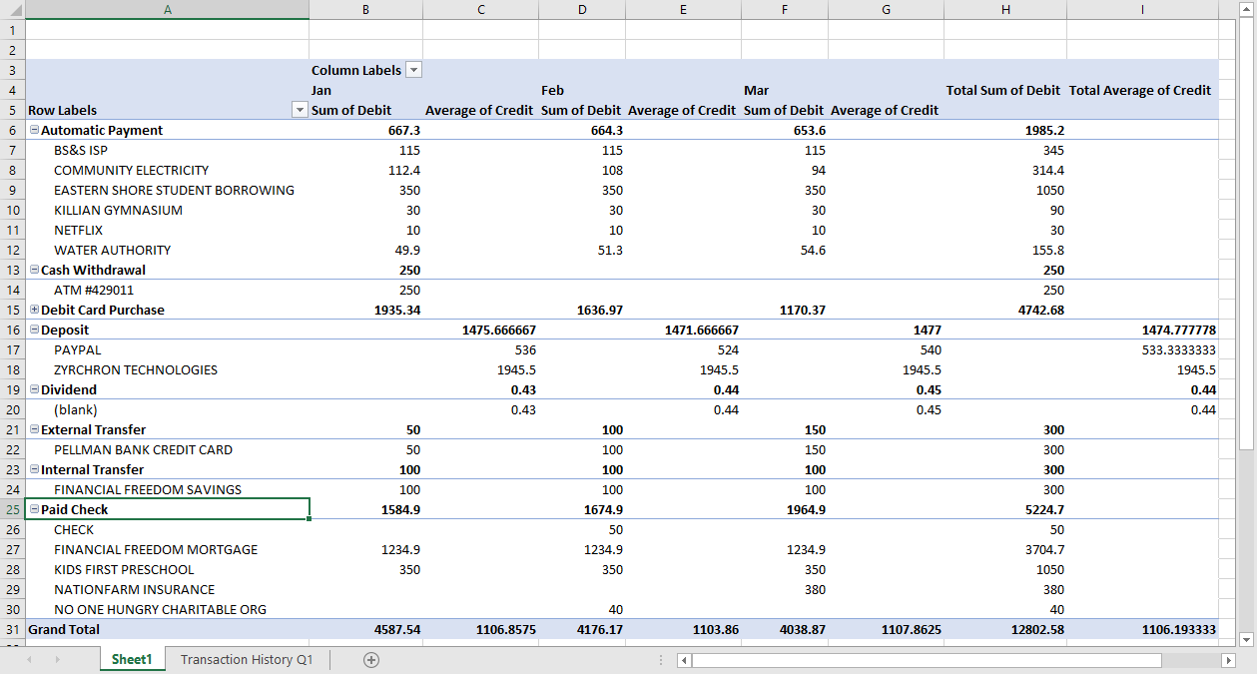
Completed PivotTable
Congratulations!
You have now completed your first PivotTable!
You can now view the sum of debit and credit amounts by month, transaction type, and description, as well as view the Grand Total of all debit and credit transactions.
Click NEXT to continue.
Notes:
Static screen

Slide 75
Create PivotCharts and Visualize Data
This topic will show how to analyze UI data by creating PivotCharts using a PivotTable.
You will also learn how to use a PivotChart to present data.
This topic explains:
The purpose and use of a PivotChart
How to visualize data using a PivotChart
How to create a dashboard to visualize and present data with a PivotTable and PivotCharts.
Click NEXT to continue.
Notes:
Topic title with Lead in and objectives

Slide 76
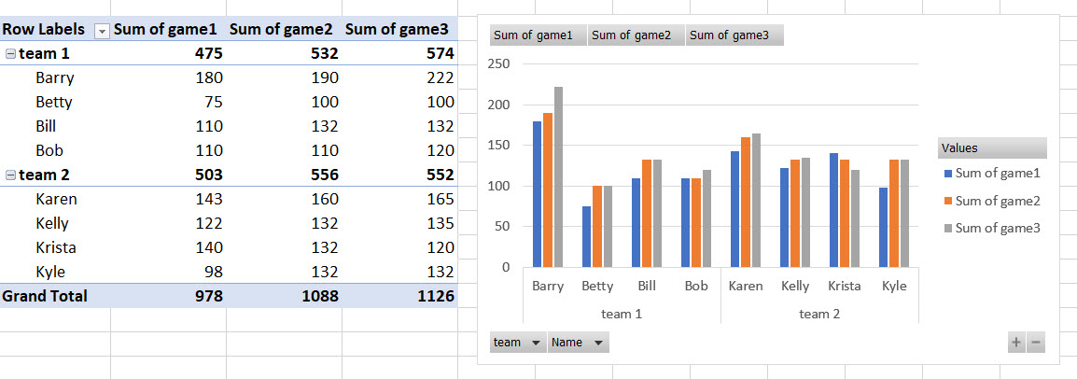
What is a PivotChart?
Another great feature of PivotTables, is that you can take the data you have analyzed in a table and quickly turn it in to a chart or graphic that will help you visualize what you have learned.
PivotChart based on Barry’s Bowling Data
Click NEXT to continue.
Notes:
Modify layout for P520_01_20.

Slide 77
PivotTable and PivotChart Relationship
A PivotChart is created based on a specific PivotTable. There is a one-to-one relationship between the PivotTable and the PivotChart. You will notice that all the elements of the PivotTable are present in the PivotChart.
PivotTable of Bowling Data
PivotChart based on PivotTable
Click NEXT to continue.
Notes:
Modify layout for P520_01_20.

Slide 78
Creating a PivotChart
Watch the video to learn how to create a PivotChart.
Use the slider bar below to pause or replay the video.
Notes:
Audio script: Creating a PivotChart is a fairly quick process, however, you must have first created a PivotTable. Once you have a PivotTable, you can select it and then go to the main menu ribbon. Select the PivotTable Analyzer menu button. The “Insert Chart” menu will open. You have several options of PivotCharts to choose from. In this example, a bar chart has been selected. The PivotChart will immediately appear next to or over top of your PivotTable. You can drag your PivotChart where you prefer. A nice feature of a PivotChart not available with standard Excel charts is that you can filter between options and update the data being shown.
Developer notes: Modify T215_002_015. Video plays when user clicks “Play” button. Video automatically enlarges to full screen with media controls underneath.

Slide 79
Add a Slicer
A Slicer is another way to help you analyze and visualize your data. A Slicer is similar to a Filter in that in helps you to quickly focus in on specific elements of your data.
In this example, Barry has created a slicer tool to be able to choose which individuals from each team he would like to view. This is very similar to how he could use a Filter, but a Slicer gives you a more easily accessible, nicely formatted menu.
Click NEXT to continue.

Slide 80
Creating a Slicer
Watch the video to learn how to create a Slicer.
Use the slider bar below to pause or replay the video.
Notes:
Audio script: Creating a Slicer is similarly fast to the process for creating a PivotChart. You simply select your PivotChart, then select the PivotTable Analyzer menu. Then select Add a Slider button. The Insert Slicer menu will appear. Select the data field you would like to use for your Slicer. In this example, Barry wants to be able to focus on different individuals. Once you have selected your data field, the Slicer will appear next to or on top of your PivotTable. Move it where you would prefer. Then you are ready to begin filtering and analyzing your data. Note how the PivotTable and PivotChart both update as the different names are selected. To return to the full PivotTable, simply selected the “x” icon on the Slicer.
Developer notes: Modify T215_002_015. Video plays when user clicks “Play” button. Video automatically enlarges to full screen with media controls underneath.

Slide 81
Present Data with a Dashboard
Now that you have a PivotTable, PivotChart, and Slider, you have what is referred to as a Dashboard. Think of a Dashboard as the PivotTable equivalent of a PowerPoint slide. You may choose to format your Dashboard to make it ready to present. For example, you may want to make a solid color background so that it resembles a slide more than a spreadsheet.
At this point, your data has been transformed from simple text and numbers into an interactive presentation tool!
Click NEXT to continue.

Slide 82
Practice Scenario: Analyze and Visualize UI Data
This topic will show how to analyze and visualize UI data by creating a PivotTable and PivotCharts.
You will also learn how to create a dashboard of a PivotTable and PivotCharts to present data.
In this topic you will demonstrate:
How to analyze UI data using a PivotTable
How to visualize UI data using PivotCharts
How to create a dashboard to visualize and present UI data with a PivotTable and PivotCharts
Click NEXT to continue.
Notes:
Topic title with Lead in and objectives

Slide 83
Scenario: Analyze UI Data
Using a PivotTable to Explore BAM Data
In addition to having a family, Barry is a BAM Supervisor. Barry wants to use his skills creating PivotTables to analyze how consistently the Investigators in his BAM Unit are identifying errors in cases.
More specifically, Barry wants to answer the following question: How many errors are each of his Investigators identifying?
In the following scenario you will:
Start with Barry’s BAM Unit source data
Create a PivotTable
Customize the PivotTable to answer questions

Slide 84
Practice Scenario: Analyze UI Data
It is time to practice each step in the process to create a PivotTable based on Barry’s Bam Unit data.
Click START when you are ready to begin the Practice Scenario.
START
In the following scenario:
You will be expected to complete a series of tasks.
You will be prompted to complete one task at a time.
You will not be able to move onto the next task until you have completed the current task.
You will have two attempts to complete each task.
If you do not correctly complete a task on your first attempt, you will receive a hint.
If you do not complete the task correctly after two tries, you will receive explicit instructions on how to complete the task.
Notes:
Developer Notes: Modify x101_10_027

Slide 85
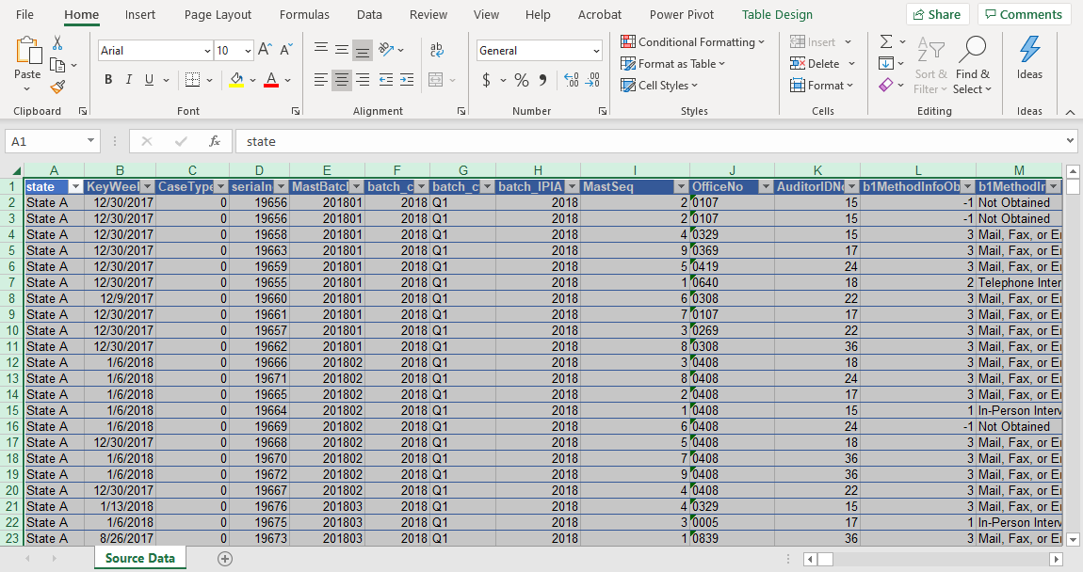
Task 1: Navigate to PivotTable Button
Navigate to correct ribbon
The source data table has been selected for you.
Select the menu in the top ribbon that contains the PivotTable button.
Tip
The PivotTable button is in the Insert ribbon.
Insert Menu
Select Insert in the top menu ribbon to navigate to the PivotTable button.
Notes:
Developer notes: Green rectangle is hotspot, not a visible green shape. Orange arrow only appears if learner incorrectly clicks somewhere other than the hotspot.
Initial prompt: Navigate to correct ribbon text box appears.
First incorrect attempt: Tip box appears.
Second incorrect attempt: Orange arrow appears along with Insert Menu box.

Slide 86
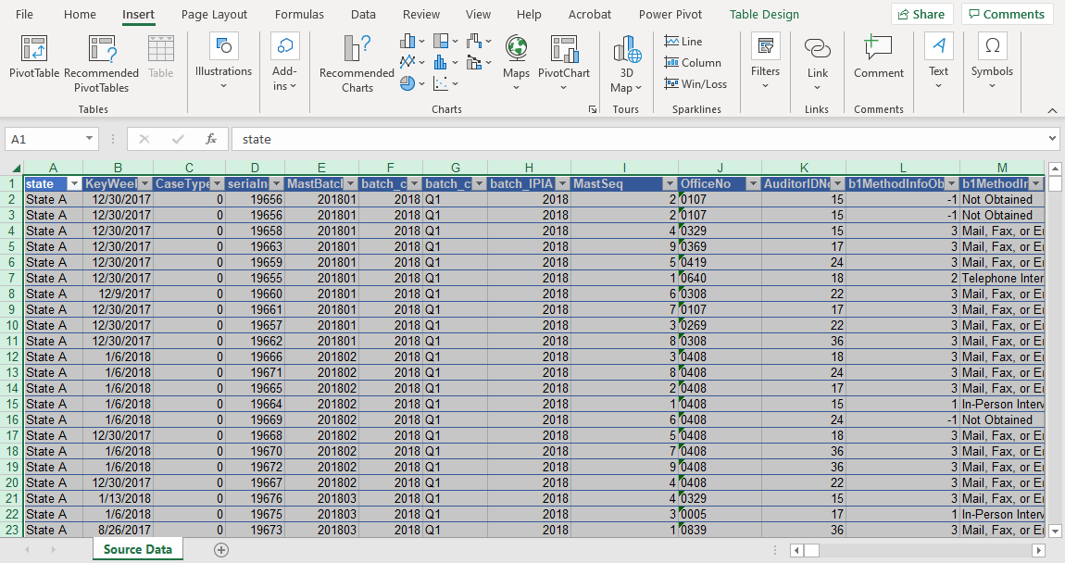
Task 2: Select Button to Create PivotTable
Select the correct button
Select the correct button in the top ribbon to create a PivotTable.
Tip
Choose the correct button the left side of the Insert ribbon.
PivotTable button
Select the PivotTable button on the left of the top ribbon.
Notes:
Developer notes: Green rectangle is hotspot, not a visible green shape. Orange arrow only appears if learner incorrectly clicks somewhere other than the hotspot.
Initial prompt: Select the correct button text box appears.
First incorrect attempt: Tip box appears along with PivotTable button box

Slide 87
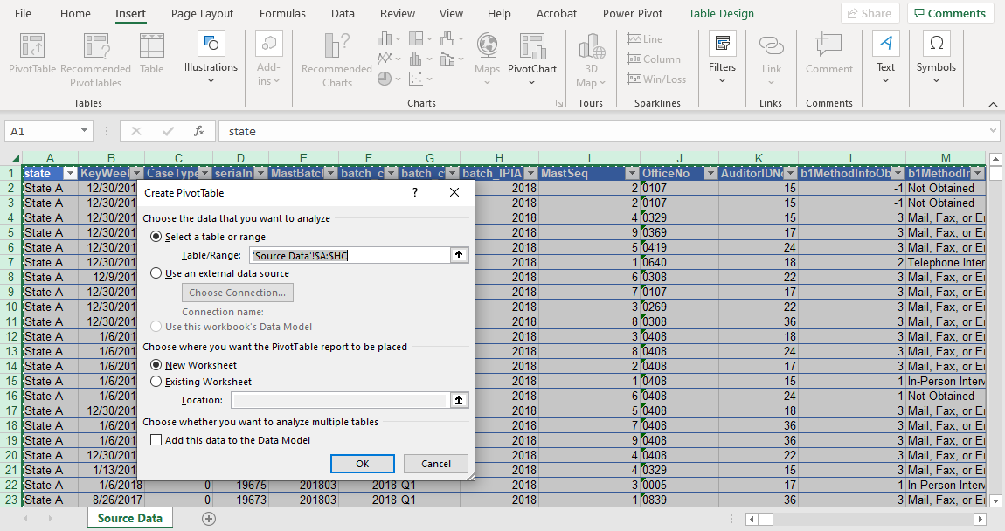
Task 3: Confirm Correct Table is Selected
Confirm Table is Selected
Verify and confirm the correct table is selected.
Tip
The ‘SourceData’1$A:$HC table is correctly selected, so select the button to confirm.
Select OK button
Select the OK button at the bottom of the Create PivotTable menu.
Notes:
Developer notes: Green rectangle is hotspot, not a visible green shape. Orange arrow only appears if learner incorrectly clicks somewhere other than the hotspot.
Initial prompt: Confirm table is selected text box appears.
First incorrect attempt: Tip box appears.
Second incorrect attempt: Orange arrow appears along with Select OK button box

Slide 88
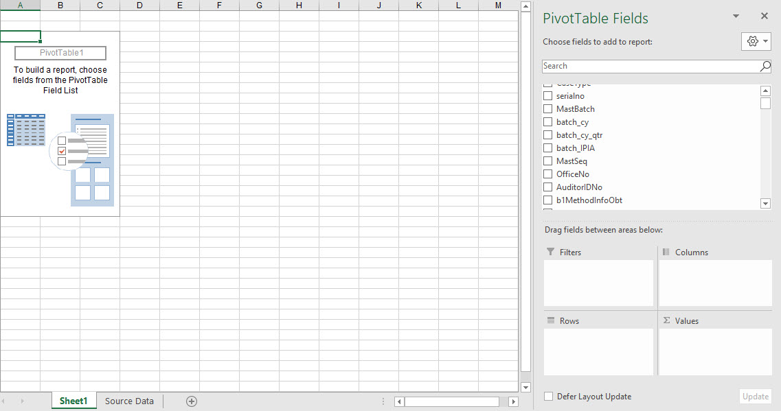
Task 4: Set Row Label
Set Row Label
Select the field that identifies individual BAM Investigators (“AuditorIDNo”) and set it as a row label.
Objective
Now that he has his data fields in the PivotTable Fields menu, Barry wants to orient his table around his Investigators. He would like a row showing an identifier for each of the BAM Investigators on his team.
Tip
Select the box next to the field that relates to an auditor ID’s and set it as a row label.
Select AuditorIDNo
Select AuditorIDNo and drag it to the Rows box. This will set AuditorIDNo as the row label for the PivotTable.
Notes:
Developer notes: Drag and drop: Learner should drag AuditorIDNo to Rows hotspot. Green boxes are only hotspots, not visible to learner. Orange arrow only appears if learner incorrectly clicks somewhere other than the hotspot.
Initial prompt: Set Row Label text box appears.
First incorrect attempt: Tip box appears.
Second incorrect attempt: Orange arrow appears with prompt “Select AuditorIDNo”

Slide 89
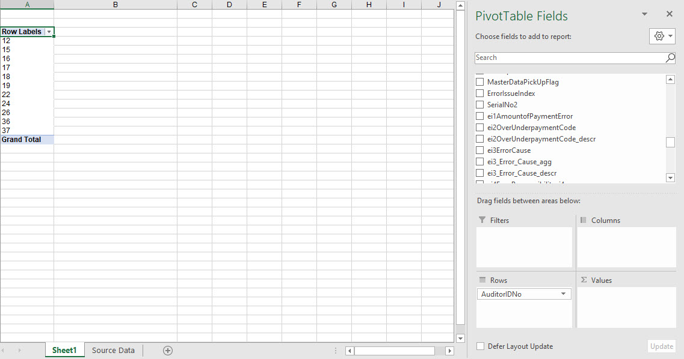
Task 5: Set Value
Set Value
Set the data field that enable you to view the total payment errors.
Tip
Select the box next to the data field that has to do with amount of Payment Errors and set it as the value.
Objective
Barry has the Auditor ID’s he needs as rows, so next he needs to identify a data field that will show all the errors identified by all of his investigators.
Select ei1 Data Field
Select the check box next to ei1AmountofPaymentError and drag it to the Values box.
Notes:
Developer notes: Drag and drop: Learner should drag Debit to Values hotspot. Green boxes are only hotspots, not visible to learner. Orange arrow only appears if learner incorrectly clicks or drags somewhere other than the hotspot.
Initial prompt: Select Value text box appears.
First incorrect attempt: Tip box appears.
Second incorrect attempt: Orange arrow appears with prompt “Select ei1 Data Field”

Slide 90
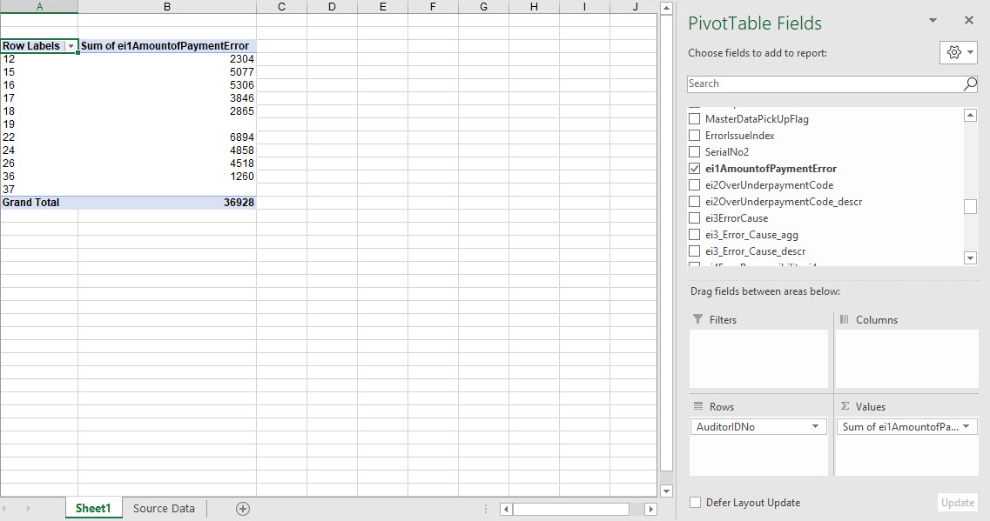
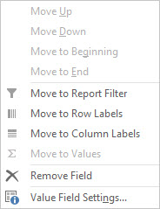
Task 6: Adjust Value
Adjust Value
Select the option in the Value dropdown menu that enables you to adjust the value being calculated.
Tip
Select the option in the Values dropdown menu that will take you to the settings for Values.
Objective
Barry has now created a simple PivotTable showing the errors identified by his investigators.
However, Barry notices the ei1 column is showing the sum of error payments and not the count of errors he is trying to analyze.
Select Value Field Settings
Select the Value Field Settings. This will take you to the Value Field Settings menu.
Notes:
Developer notes: Drag and drop: Learner should drag Credit to Values hotspot. Green boxes are only hotspots, not visible to learner. Orange arrow only appears if learner incorrectly clicks or drags somewhere other than the hotspot.
Initial prompt: Adjust Value text box appears.
First incorrect attempt: Tip box appears.
Second incorrect attempt: Orange arrow appears with prompt “Select Value Fields Settings”

Slide 91
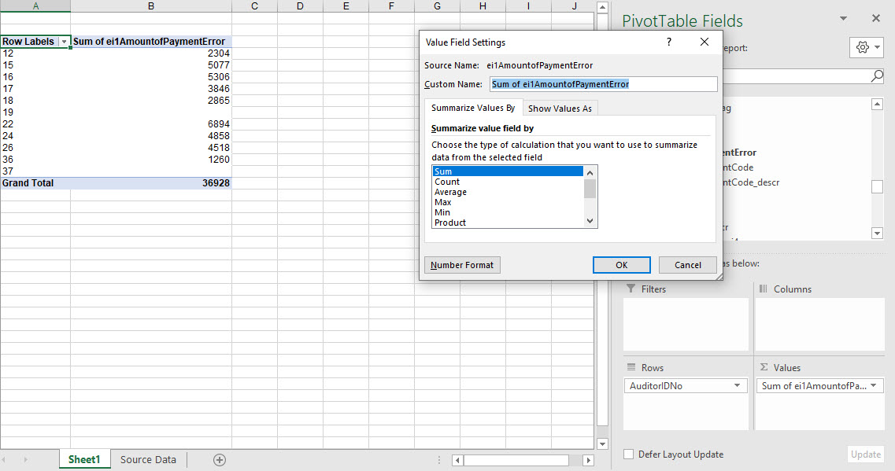
Task 7: Change Value Field Setting
Set Value to Count Errors
Set the data field that will enable you to view additional information on the transaction type.
Tip
Select the value field that will count the errors instead of the sum of payment amount.
Objective
Now that the Value Field Settings menu is open Barry is ready to change the type of value being calculated to count the errors detected.
Select Description
Select Count. This will adjust the type of calculation to count errors rather than the sum or payment amounts.
Notes:
Developer notes: Drag and drop: Learner should drag Description to Rows hotspot. Green boxes are only hotspots, not visible to learner. Orange arrow only appears if learner incorrectly clicks somewhere other than the hotspot.
Initial prompt: Set Value to Count Errors text box appears.
First incorrect attempt: Tip box appears.
Second incorrect attempt: Orange arrow appears with prompt “Select Count”

Slide 92
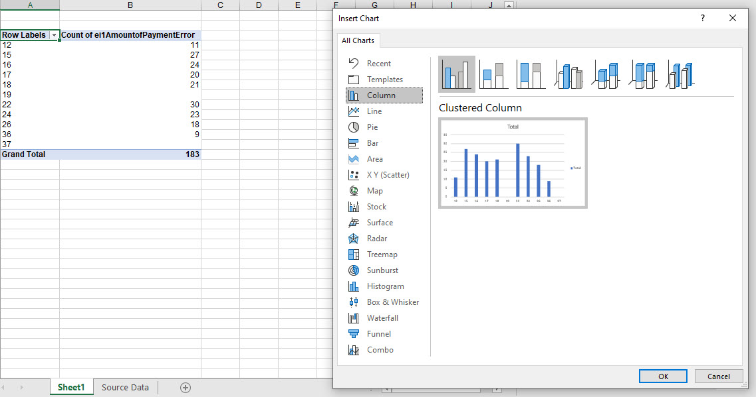
Task 8: Create PivotChart
Create a Bar PivotChart
Select the option that will enable Barry to create a Bar PivotChart.
Tip
Select the option in the All Charts menu that will create a Bar PivotChart.
Objective
Barry is now able to clearly see the number of errors detected by each Investigator as well as the total for the BAM Unit.
Select Bar
Select Bar in the All Charts menu. This create a PivotChart of the data in the PivotTable.
However, Barry would like a more visual breakdown of the data so he navigates to the PivotChart menu.
Notes:
Developer notes: Drag and drop: Learner should drag Transaction Date to Columns hotspot. Green boxes are only hotspots, not visible to learner. Orange arrow only appears if learner incorrectly clicks somewhere other than the hotspot.
Initial prompt: Create Bar Chart text box appears.
First incorrect attempt: Tip box appears.
Second incorrect attempt: Orange arrow appears with prompt “Select Bar”

Slide 93
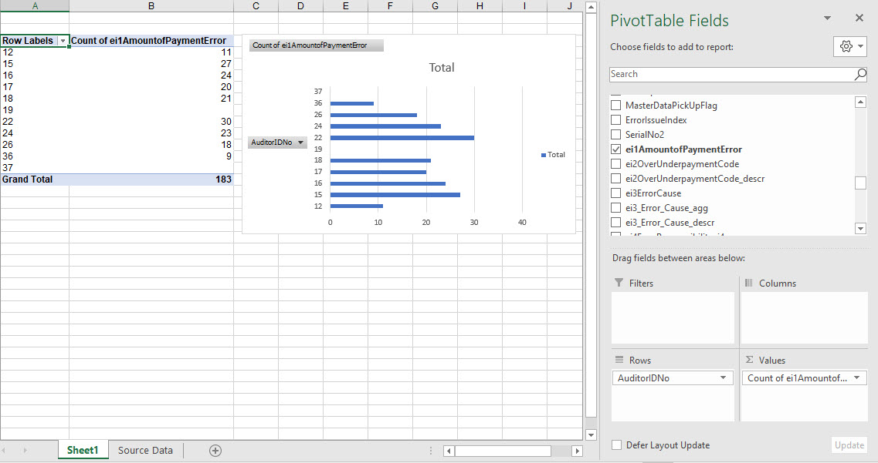
Question Answered
Answer to Barry’s Question
Now Barry has created a PivotTable and PivotChart of the number of errors detected by the investigators in his BAM Unit, he can analyze and visualize his data.
If he wanted to present his data, he could choose to continue to customize his PivotTable, as well as add PivotCharts and Slicers to create a Dashboard.

Slide 94
Completed PivotTable and PivotChart
Congratulations!
You have now learned how to create a PivotTable and PivotChart to analyze and visualize UI data!
Begin thinking about what questions you might have and how you can use PivotTables and PivotCharts to begin analyzing your data!
Click NEXT to continue.
Notes:
Static screen

