Slide 1
Azure PMM Onboarding Experience
Introductory Video:
An Overview of the
Onboarding Program
Module length – 8 minutes
Notes:
Duration: 3 seconds
Objective: Welcome audience to the Introductory vignette
Scene#: 1
Script:
(Background music)
Length of voiceover: :05
Outline:
PowerPoint
Elements:
Full screen photograph representing a welcoming group of people.
MSFT ‘Pure’ audio background music begins.

Slide 2
What
we will cover
Notes:
Duration: 3 seconds
Objective: Transition slide
Audio: MS Pure audio continues in background

Slide 3
Greeting from key stakeholders
Key program objectives
A guide to navigating the Modules of Training
Welcome
Overview of form factors, method and media
Post-module surveys and checklists
Get to know your portal features
Notes:
Duration: 34 seconds
Objective: Objectives for Introductory vignette
Scene#: 2
Script:
Welcome to Azure PMM Onboarding!
In this introductory video, we will introduce you to key stakeholders in the Azure PMM Onboarding process. You will learn about the program objectives and see how to navigate the modules of training. This video also covers the form factors, method and media that make up each module. You will review the post-module surveys and checklists you will need to complete before continuing to the next module. Finally, you will learn about the portal and the many other resources available to you during the Onboarding process.
Length of voiceover: 00:34 seconds
Outline:
PowerPoint
Elements: Text and images introducing objectives.

Slide 4
Welcome
messages
Notes:
Duration: 3 seconds
Objective: Transition slide
Audio: MS Pure audio continues in background

Slide 5
Placeholder for Guest Speaker #1 video
Notes:
Duration: 26 seconds
Objective: Introduction to PMM Onboarding process by (Guest Speaker #1).
Scene#: 3
Script: (Transcript of Guest Speaker #1 video)
Length of voiceover: 00:26 seconds
Outline:
PowerPoint
Elements: Video of (Guest Speaker #1) embedded plays automatically.

Slide 6
Placeholder for Guest Speaker #2 video
Notes:
Duration: 46 seconds
Objective: Overview of PMM Onboarding by (Guest Speaker #2).
Scene#: 4
Script: (Transcript of Guest Speaker #2 video)
Length of voiceover: 00:46 seconds
Outline:
PowerPoint
Elements: Video of (Guest Speaker #2) embedded plays automatically.

Slide 7
Program
objectives
Notes:
Duration: 2 seconds
Objective: Transition slide to program objectives.
Audio: MS Pure audio continues in background

Slide 8
Program
Promote awareness
Achieve readiness
objectives
Capture best practices
Connect to resources
Provide support
Notes:
Duration: 29 seconds
Objectives: Overview of program objectives.
Scene#: 5
Script:
The purpose of Azure PMM Onboarding goes beyond training. This is not a seminar you attend, but an on-going process that promotes awareness of resources in order to help our team achieve readiness. Throughout the onboarding process, best practices are captured to further refine our offerings. You will be connected with training resources, as well as the people who can help you continue to develop new skills and knowledge. The idea is provide the support you need to gain mastery.
Length of voiceover: 00:29 seconds
Elements: Lifestyle image with bullet points.

Slide 9
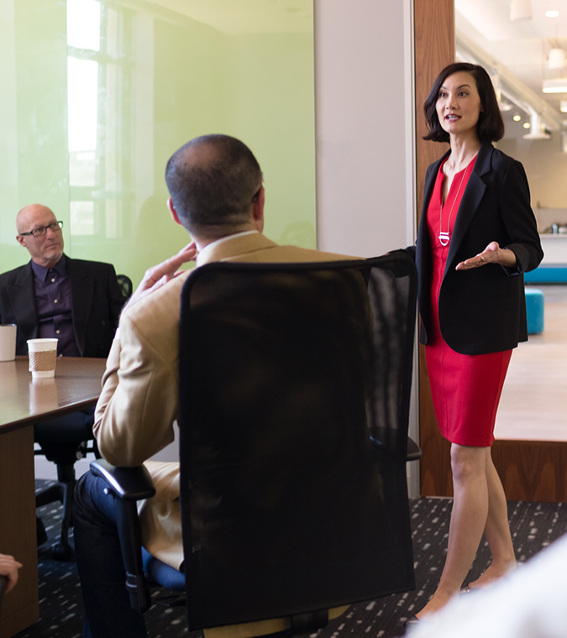
Key pillars of Azure PMM
Understand the RoB
Azure PMM Tools
Marketing Insights
Notes:
Duration: 16 seconds
Objectives: Overview of program objectives.
Scene#: 5 (cont.)
Script:
Within each module you will learn about the key pillars of the Azure PMM, so that you can gain an understanding of the rhythm of the business. The onboarding process will also introduce you to Azure PMM Tools as well as Marketing Insights.
Length of voiceover: 00:16 seconds
Elements: Lifestyle image with bullet points.

Slide 10
Modules
of training
Notes:
Duration: 2 seconds
Objective: Transition slide to sequence and overview of training modules.
Audio: MS Pure audio continues in background

Slide 11
Modules
of training
Module 1
Introduction to C+E
Module 2
Introduction to Azure
Module 3
Azure PMM Tools
Module 4
Azure Marketing Insights
Module 5
Best Practices and Events
Notes:
Duration: 22 seconds
Objective: Provide overview of sequence training modules.
Scene#: 6
Script:
Over the course of the Azure PMM Onboarding process, you will take five different training modules in order. The names of module are Introduction to C+E, Introduction to Azure, Azure PMM Tools, Azure Marketing Insights and Best Practices and Events.
Length of voiceover: 00:22
Outline:
PowerPoint
Elements: Slide with modules flying in as they are introduced.

Slide 12
Introduction to C+E
Introduction to Azure
Azure PMM Tools
Azure Marketing Insights
Best Practices and Events
Tool demonstrations
Best practices
Method and media in modules
Tutorials
Testimonials
Videos
Notes:
Duration: 23 seconds
Objective: Provide overview of sequence training modules.
Scene#: 6 (cont.)
Script:
Each of the five modules will cover different content, but include the same elements, such as tool demonstrations, tutorials, videos, testimonials and best practices. Post-module surveys and checklists will follow each training module to help map learning. Both the survey and checklist must be completed before you can begin the next module.
Length of voiceover: 00:23 seconds
Outline:
PowerPoint
Elements: Slide with the resources flying in as they are introduced.

Slide 13
Let’s
look at the portal
Notes:
Duration: 2 seconds
Objective: Transition slide to learning portal and additional resources.
Audio: MS Pure audio continues in background

Slide 14
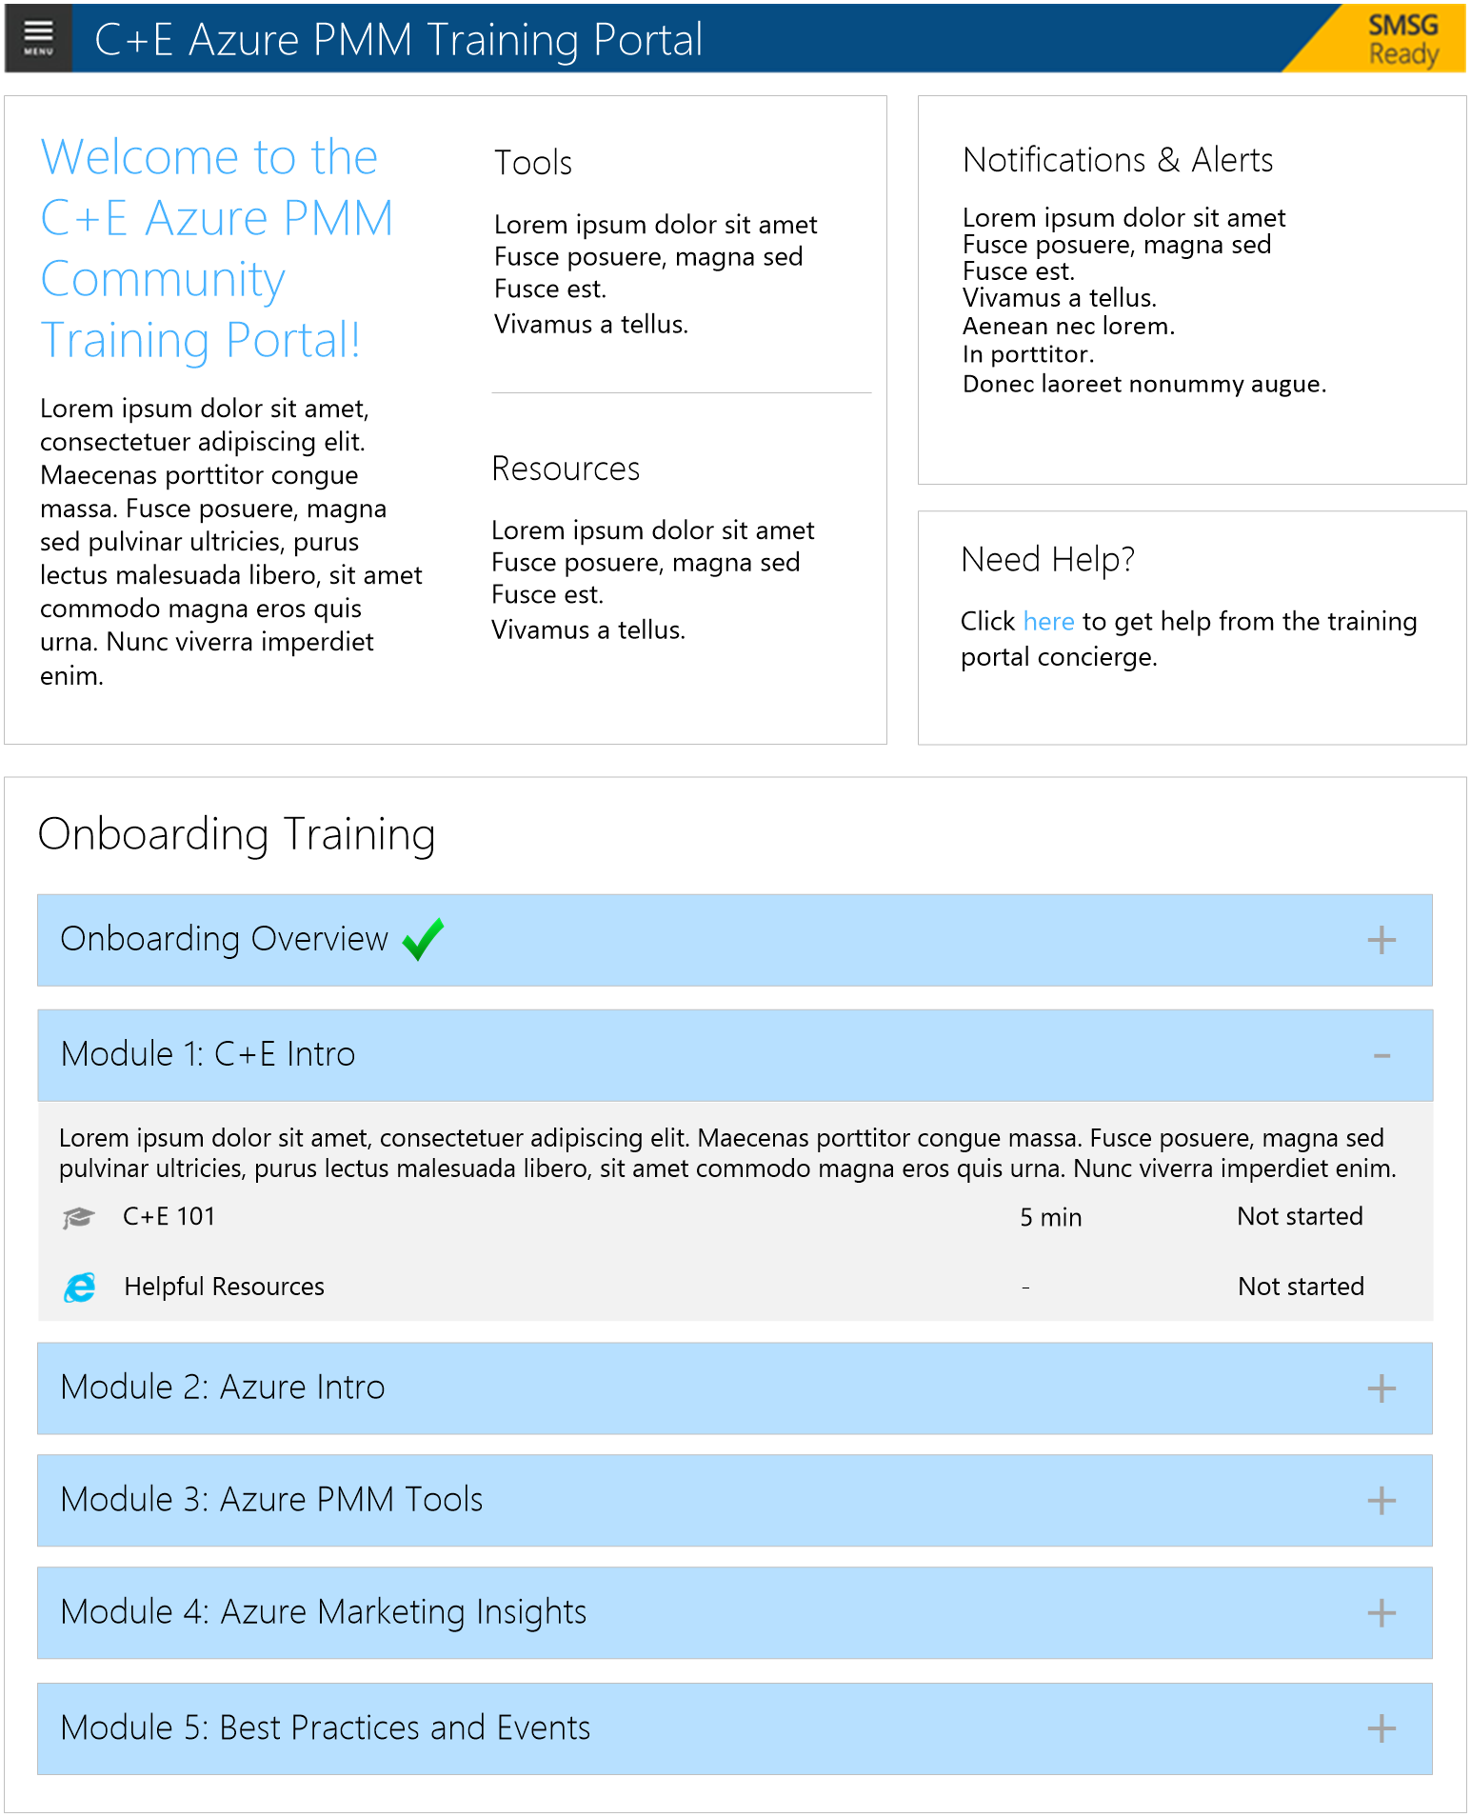
Let’s
Training modules
Resource library
look at the portal
Help-needed for dynamic support
Upcoming events
Recorded summits
Notes:
Duration: 29 seconds
Objectives: Overview of post-module checklists.
Scene#: 7
Script:
Let’s take a look at the portal before we go over the specifics of the modules. After all, the portal will help you navigate through the training path. The learning portal hosts all of the training modules and content, such as videos, surveys and checklists, not to mention a robust resource library. You can also use the help-needed function to track down exactly what you need. You will also receive timely communications about upcoming events and you can even review recent events you may have missed. Now it’s time to take a close look at Module 1.
Length of voiceover: 00:29 seconds
Elements: Screenshot of learning portal resources with bullet points.

Slide 15
Module 1:
Introduction to C+E
Introduction to C+E
Key Subjects:
C+E FY17 Field Planning and Execution Guide
C+E Business Portal
C+E Azure PMM Roles and Commitments
Introduction to Azure
Overview:
Introduction to C+E and the core scenarios, as well as key resources. Roles and commitments of an Azure PMM.
Azure PMM Tools
Form Factor:
Video, tutorials, testimonials and tool demonstrations
Azure Marketing Insights
SME Speakers:
TBD
Duration:
One week
Best Practices and Events
Completion:
Post-module surveys and checklists
Notes:
Duration: 47 seconds
Objective: Provide overview of learning module 2: Introduction to C+E.
Scene#: 8
Script:
The first module is Introduction to C+E. This module covers key subjects of the C+E FY17 Field Planning and Execution Guide, C+E Business Portal, and the C+E Azure PMM Roles and Commitments. You will be introduced to C+E and the core scenarios, as well as key resources. You will also learn about the roles and commitments of an Azure PMM. All of the modules have certain elements in common, such as the use of videos, tutorials, testimonials and demonstrations of tools and resources. You will also hear from guest speakers related to the content of each module. Finally, like Module 1, subsequent modules will last approximately one week and will require you to complete a post-module survey and checklist before proceeding to the next module.
Length of voiceover: 00:47 seconds
Outline:
PowerPoint
Elements: Image with bullet points.

Slide 16
Module 2:
Introduction to Azure
Introduction to C+E
Key Subjects:
MS Azure Stack
Azure production information
Azure motions
Access Azure
Introduction to Azure
Overview:
Introduction to Azure and production tools. Comprehensive information about Azure motions. Overview of the information that can be accessed.
Azure PMM Tools
Form Factor:
Video, tutorials, testimonials and tool demonstrations
Azure Marketing Insights
SME Speakers:
TBD
Duration:
One week
Best Practices and Events
Completion:
Post-module surveys and checklists
Notes:
Duration: 45 seconds
Objective: Provide overview of learning module 1: Introduction to Azure.
Scene#: 9
Script:
The second module is Introduction to Azure. This module covers the key subjects of Microsoft Azure Stack, Azure production information, Azure motions and Access Azure. You will be introduced to Azure and the production tools. You will also go over comprehensive information about Azure motions and an overview of how to access the information. The module includes video with tutorials and testimonials and demonstrations of tools and resources. You will hear Ibrahim Hamza discuss Azure and keys to success. The module lasts one week and you will complete a post-module survey and checklist before proceeding to Module 3.
Length of voiceover: 00:45 seconds
Outline:
PowerPoint
Elements: Image with bullet points.

Slide 17
Module 3:
Azure PMM Tools
Introduction to C+E
Key Subjects:
C+E Insights
Azure Health Report
C+E Direct Dashboard
Azure Consumption
Introduction to Azure
Overview:
Overview of Azure PMM tools and how to access the most relevant information on Azure. Access vital information such as revenue and consumption.
Azure PMM Tools
Form Factor:
Video, tutorials, testimonials and tool demonstrations
Azure Marketing Insights
SME Speakers:
TBD
Duration:
One week
Best Practices and Events
Completion:
Post-module surveys and checklists
Notes:
Duration: 45 seconds
Objective: Provide overview of learning module 3: Introduction to C+E.
Scene#: 10
Script:
The third module is Azure PMM Tools. This module covers the key subjects of C+E Insights, Azure Health Report, C+E Direct Dashboard and Azure Consumption. The module is an overview of Azure PMM tools and how to access the vital information on Azure, such as revenue and consumption. Similar to previous modules, video with tutorials and testimonials and demonstrations of tools and resources are used to deliver the training. You will also get insights from Nate Findley and Natalie Duryea. The module lasts one week and you will complete a post-module survey and checklist before proceeding to Module 4.
Length of voiceover: 00:45 seconds
Outline:
PowerPoint
Elements: Image with bullet points.

Slide 18
Module 4:
Azure Marketing Insights
Introduction to C+E
Key Subjects:
Azure GearUp
WWSMM
Azure Yammer Community
Modern Marketing Field Playbook
Introduction to Azure
Overview:
Comprehensive look at the marketing materials available for Azure. How to identify the community surrounding Azure and leverage their expertise.
Azure PMM Tools
Form Factor:
Video, tutorials, testimonials and tool demonstrations
Azure Marketing Insights
SME Speakers:
TBD
Duration:
One week
Best Practices and Events
Completion:
Post-module surveys and checklists
Notes:
Duration: 45 seconds
Objective: Provide overview of learning module 4: Azure Marketing Insights.
Scene#: 11
Script:
The fourth module is Azure Marketing Insights. This module covers the key subjects of Azure GearUp, WWSMM, Azure Yammer Community and the Modern Marketing Field Playbook. The module provides a comprehensive look at the marketing materials available for Azure. You will also learn how to identify the marketing community surrounding Azure and the best ways to leverage their expertise. The module includes video with tutorials and testimonials and demonstrations of tools and resources. In this module, you will also gain marketing insights from Ruth Ericson. The module lasts one week and you will complete a post-module survey and checklist before proceeding to Module 5.
Length of voiceover: 00:45 seconds
Outline:
PowerPoint
Elements: Image with bullet points.

Slide 19
Module 5:
Best Practices and Events
Introduction to C+E
Key Subjects:
S4
TechReady
Key Events
User how-to videos
Introduction to Azure
Overview:
Access recent and upcoming events. View best practices for Azure PMMs from people in the field. Identify key events that occur throughout the year.
Azure PMM Tools
Form Factor:
Video, tutorials, testimonials and tool demonstrations
Azure Marketing Insights
SME Speakers:
TBD
Duration:
One week
Best Practices and Events
Completion:
Post-module surveys and checklists
Notes:
Duration: 37 seconds
Objective: Provide overview of learning module 5: Best Practices and Events.
Scene#: 12
Script:
The fifth module is Best Practices and Events. This module covers the key subjects of S4, TechReady, Key Events and User how-to videos. You will learn how to access recent and upcoming events that provide the best practices to Azure PMMs like yourself from people in the field. Video with tutorials and testimonials as well as demonstrations of tools and resources will guide you through the module’s content. The module lasts one week and you will complete a post-module survey and checklist before completing the training.
Length of voiceover: 00:37 seconds
Outline:
PowerPoint
Elements: Image with bullet points.

Slide 20
Surveys
on progress
Notes:
Duration: 2 seconds
Objective: Transition slide to Survey content.
Audio: MS Pure audio continues in background

Slide 21
Module 1: Self-evaluation survey
On a scale of 1-5, please rate your level of agreement for the comments below. (1- strong disagreement, 5-strong agreement)
I know where to access the primary source of communications, collateral, business intelligence and resources for all product groups and businesses within Cloud + Enterprise Business.
I know where to access the C+E ROB and the Azure PMM ROB, and have a high-level understanding of each of the major ROB events.
I have a strong understanding of my role and priorities in C+E.
I know where to access information about other products in C+E.
I have setup my 1:1 meetings with my manager and my colleagues.
Post-module surveys
Reflect on learning
Communicate progress
Notes:
Duration: 22 seconds
Objectives: Overview of post-module surveys.
Scene#: 13
Script:
You will complete a survey following each of the five modules. The surveys will focus primarily on how the content maps to your role. You will answer questions that help you reflect on what you have learned, and also inform stakeholders how you feel about your progress. The surveys are not graded, and take no more than 2-3 minutes to complete.
Length of voiceover: 00:22 seconds
Elements: Screenshot of completed survey with bullet points.

Slide 22
Post-module
checklists
Notes:
Duration: 2 seconds
Objective: Transition slide to Checklists content.
Audio: MS Pure audio continues in background

Slide 23
Request an initial meeting with your Manager after reviewing the C+E Field Portal:
Discuss state of business.
Discuss key business imperatives, key responsibilities, and objectives.
Understand rhythm of the business and how you will be participating
Review comprehensive listing of MS business terminology and internalize acronyms.
Set up ongoing meetings:
Bi-weekly/monthly meetings/1:1 with your Manager
Set up ongoing Monthly meetings with those people that you share mutual dependencies with.
EPG lead; DX Lead; OEM Lead; SMS&P Lead; M&O Lead
CCG Lead; CMO Lead;
Your local area Finance Lead
Other Key C+E Partners such as HR; Compete lead; CATM; BPO Lead; Windows BG Lead; MOD BG lead; Enterprise Marketing lead; CMO Lead; LCA team/Lead
Post-module checklists
Identify resources
Tailored to your learning
Connect with people
Notes:
Duration: 27 seconds
Objectives: Overview of post-module checklists.
Scene#: 14
Script:
A checklist will also accompany each module. You will complete a list of follow-up tasks that will help you to identify additional resources. You will need to complete all the items on the checklist before you can advance to the next module, but don’t think of this as homework. The checklist is tailored to your learning in your new role, and is intended to help connect you with the right people at the right moment in your onboarding process.
Length of voiceover: 00:27 seconds
Elements: Screenshot of completed checklist with bullet points.

Slide 24
Let’s
get started
Notes:
Duration: 12 seconds
Objectives: Review next steps in onboarding process.
Scene#: 15
Script:
You have now completed the Introductory video for the Azure PMM Onboarding process. You are ready to get started on Module 1: Introduction to C+E. Good luck!
Length of voiceover: 00:12 seconds
Elements: Lifestyle image with text.

